Slide 1
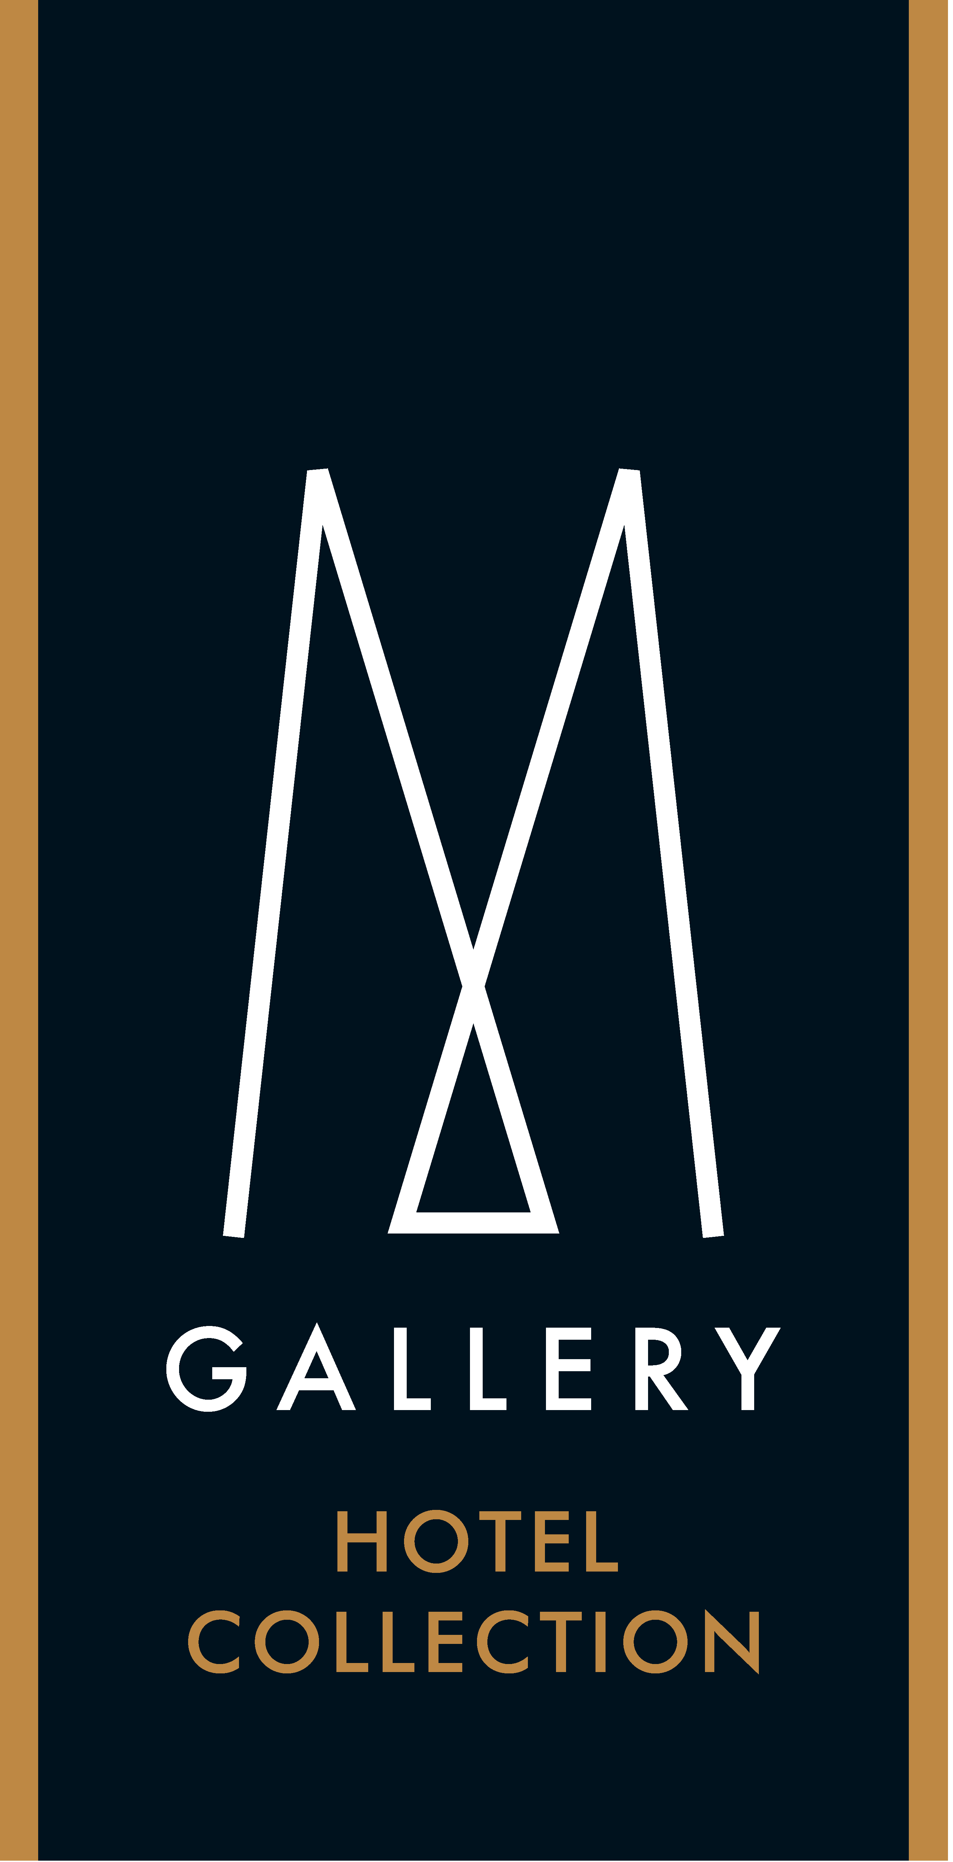

Slide 2
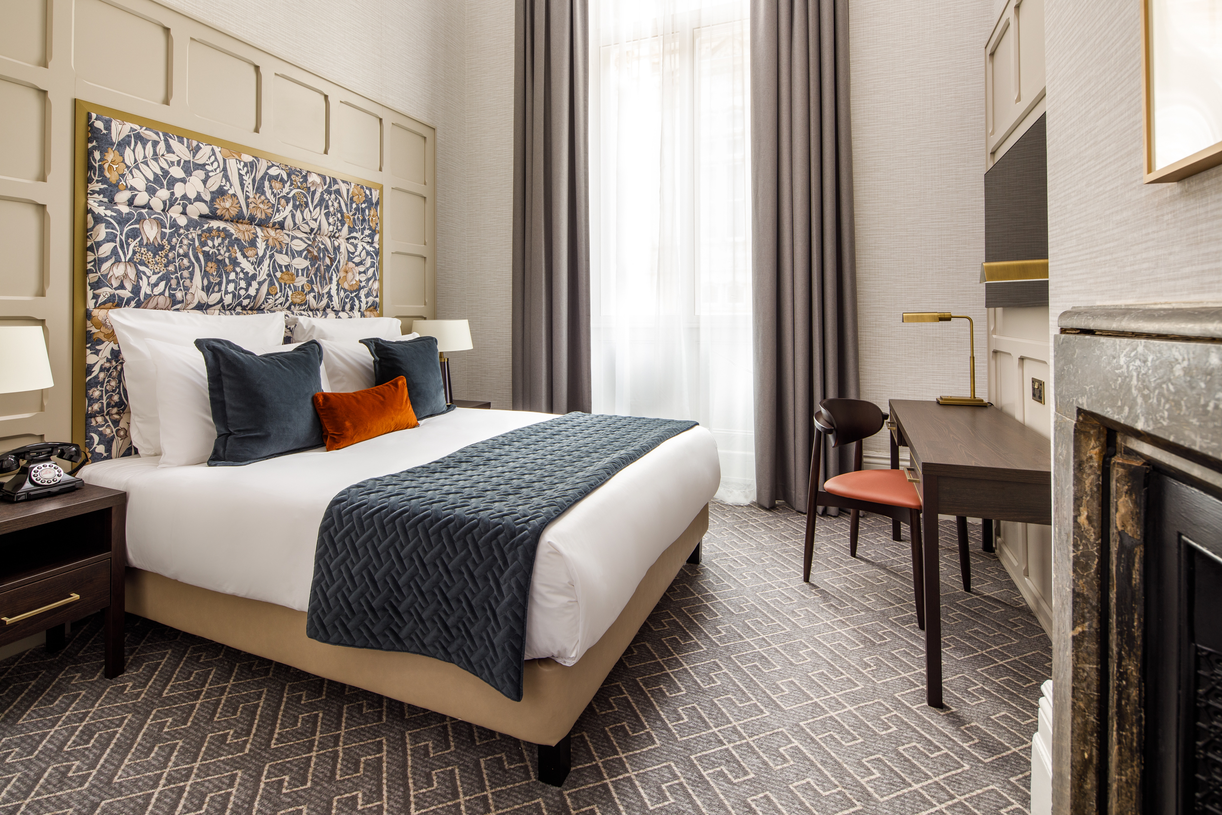
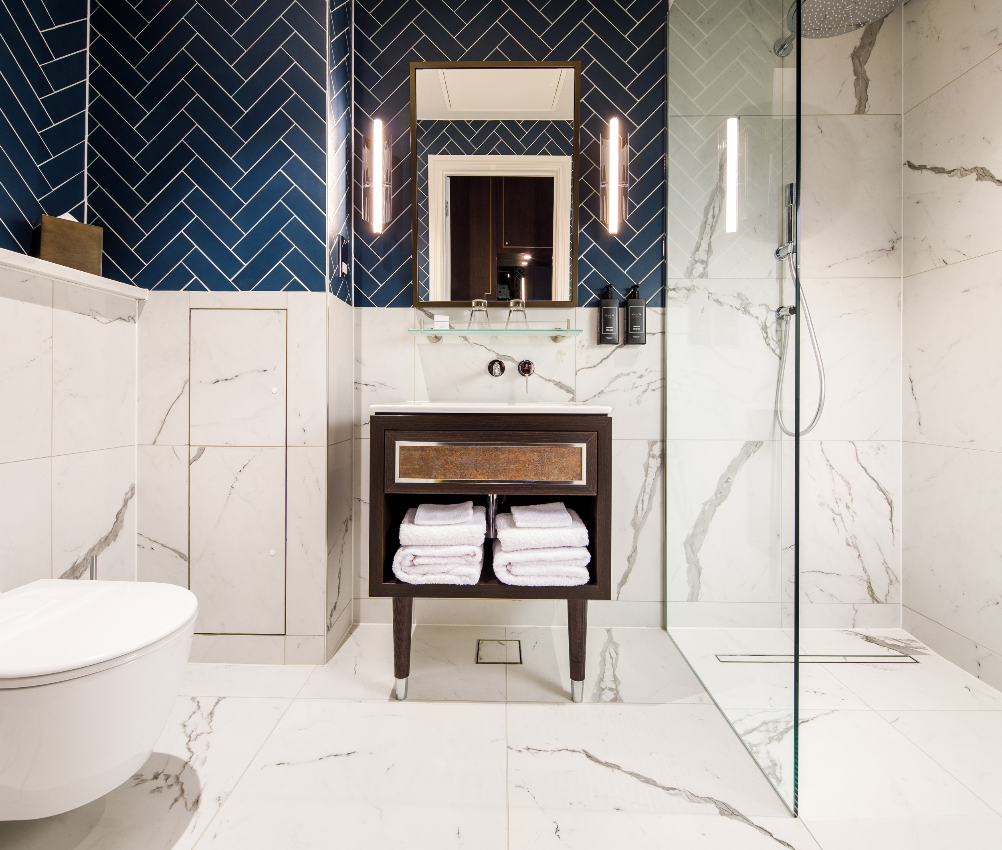
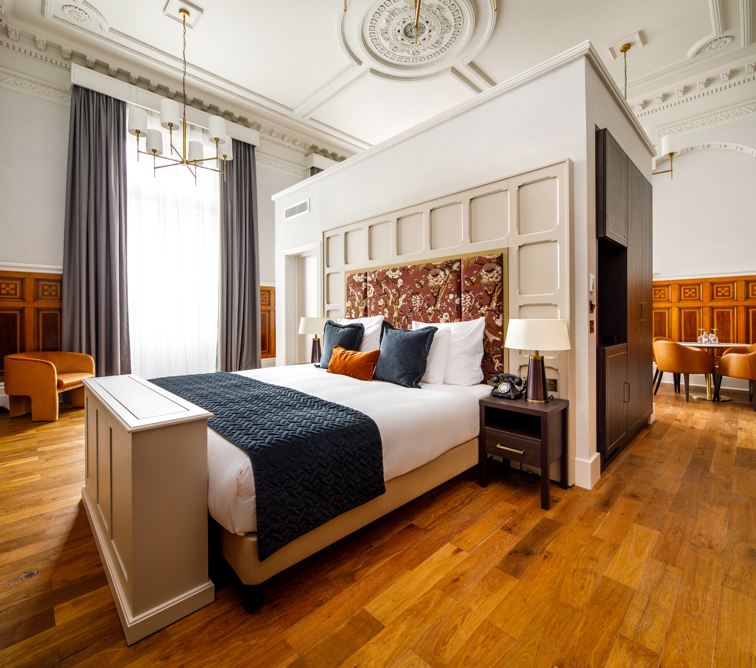
THE MUNICIPAL HOTEL LIVERPOOL - MGALLERY
Rooms and suites
The Municipal Hotel Liverpool offers 175 lavish rooms and 4 suites stylishly decorated. Be on your way to a relaxing sleep by stepping on one of the four sweeping staircases – another design statement of the landmark. The building was specifically built for Liverpool City Council workers back in 1868 and is grade II listed.

Slide 3
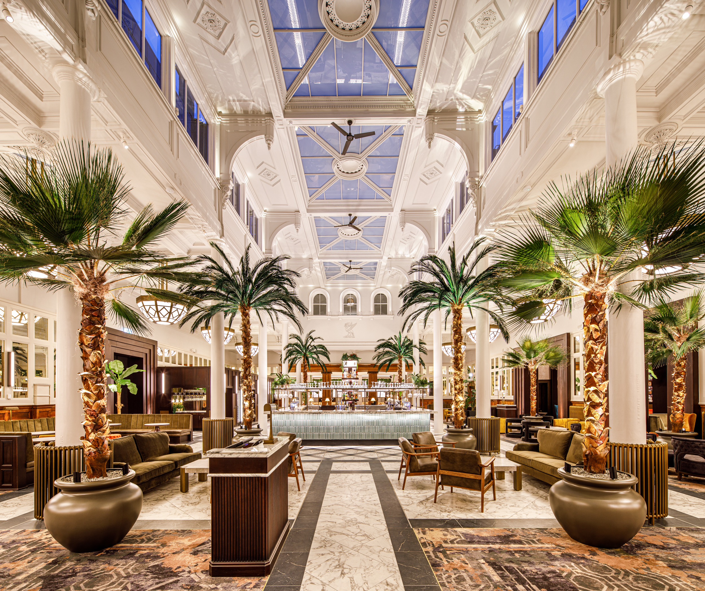
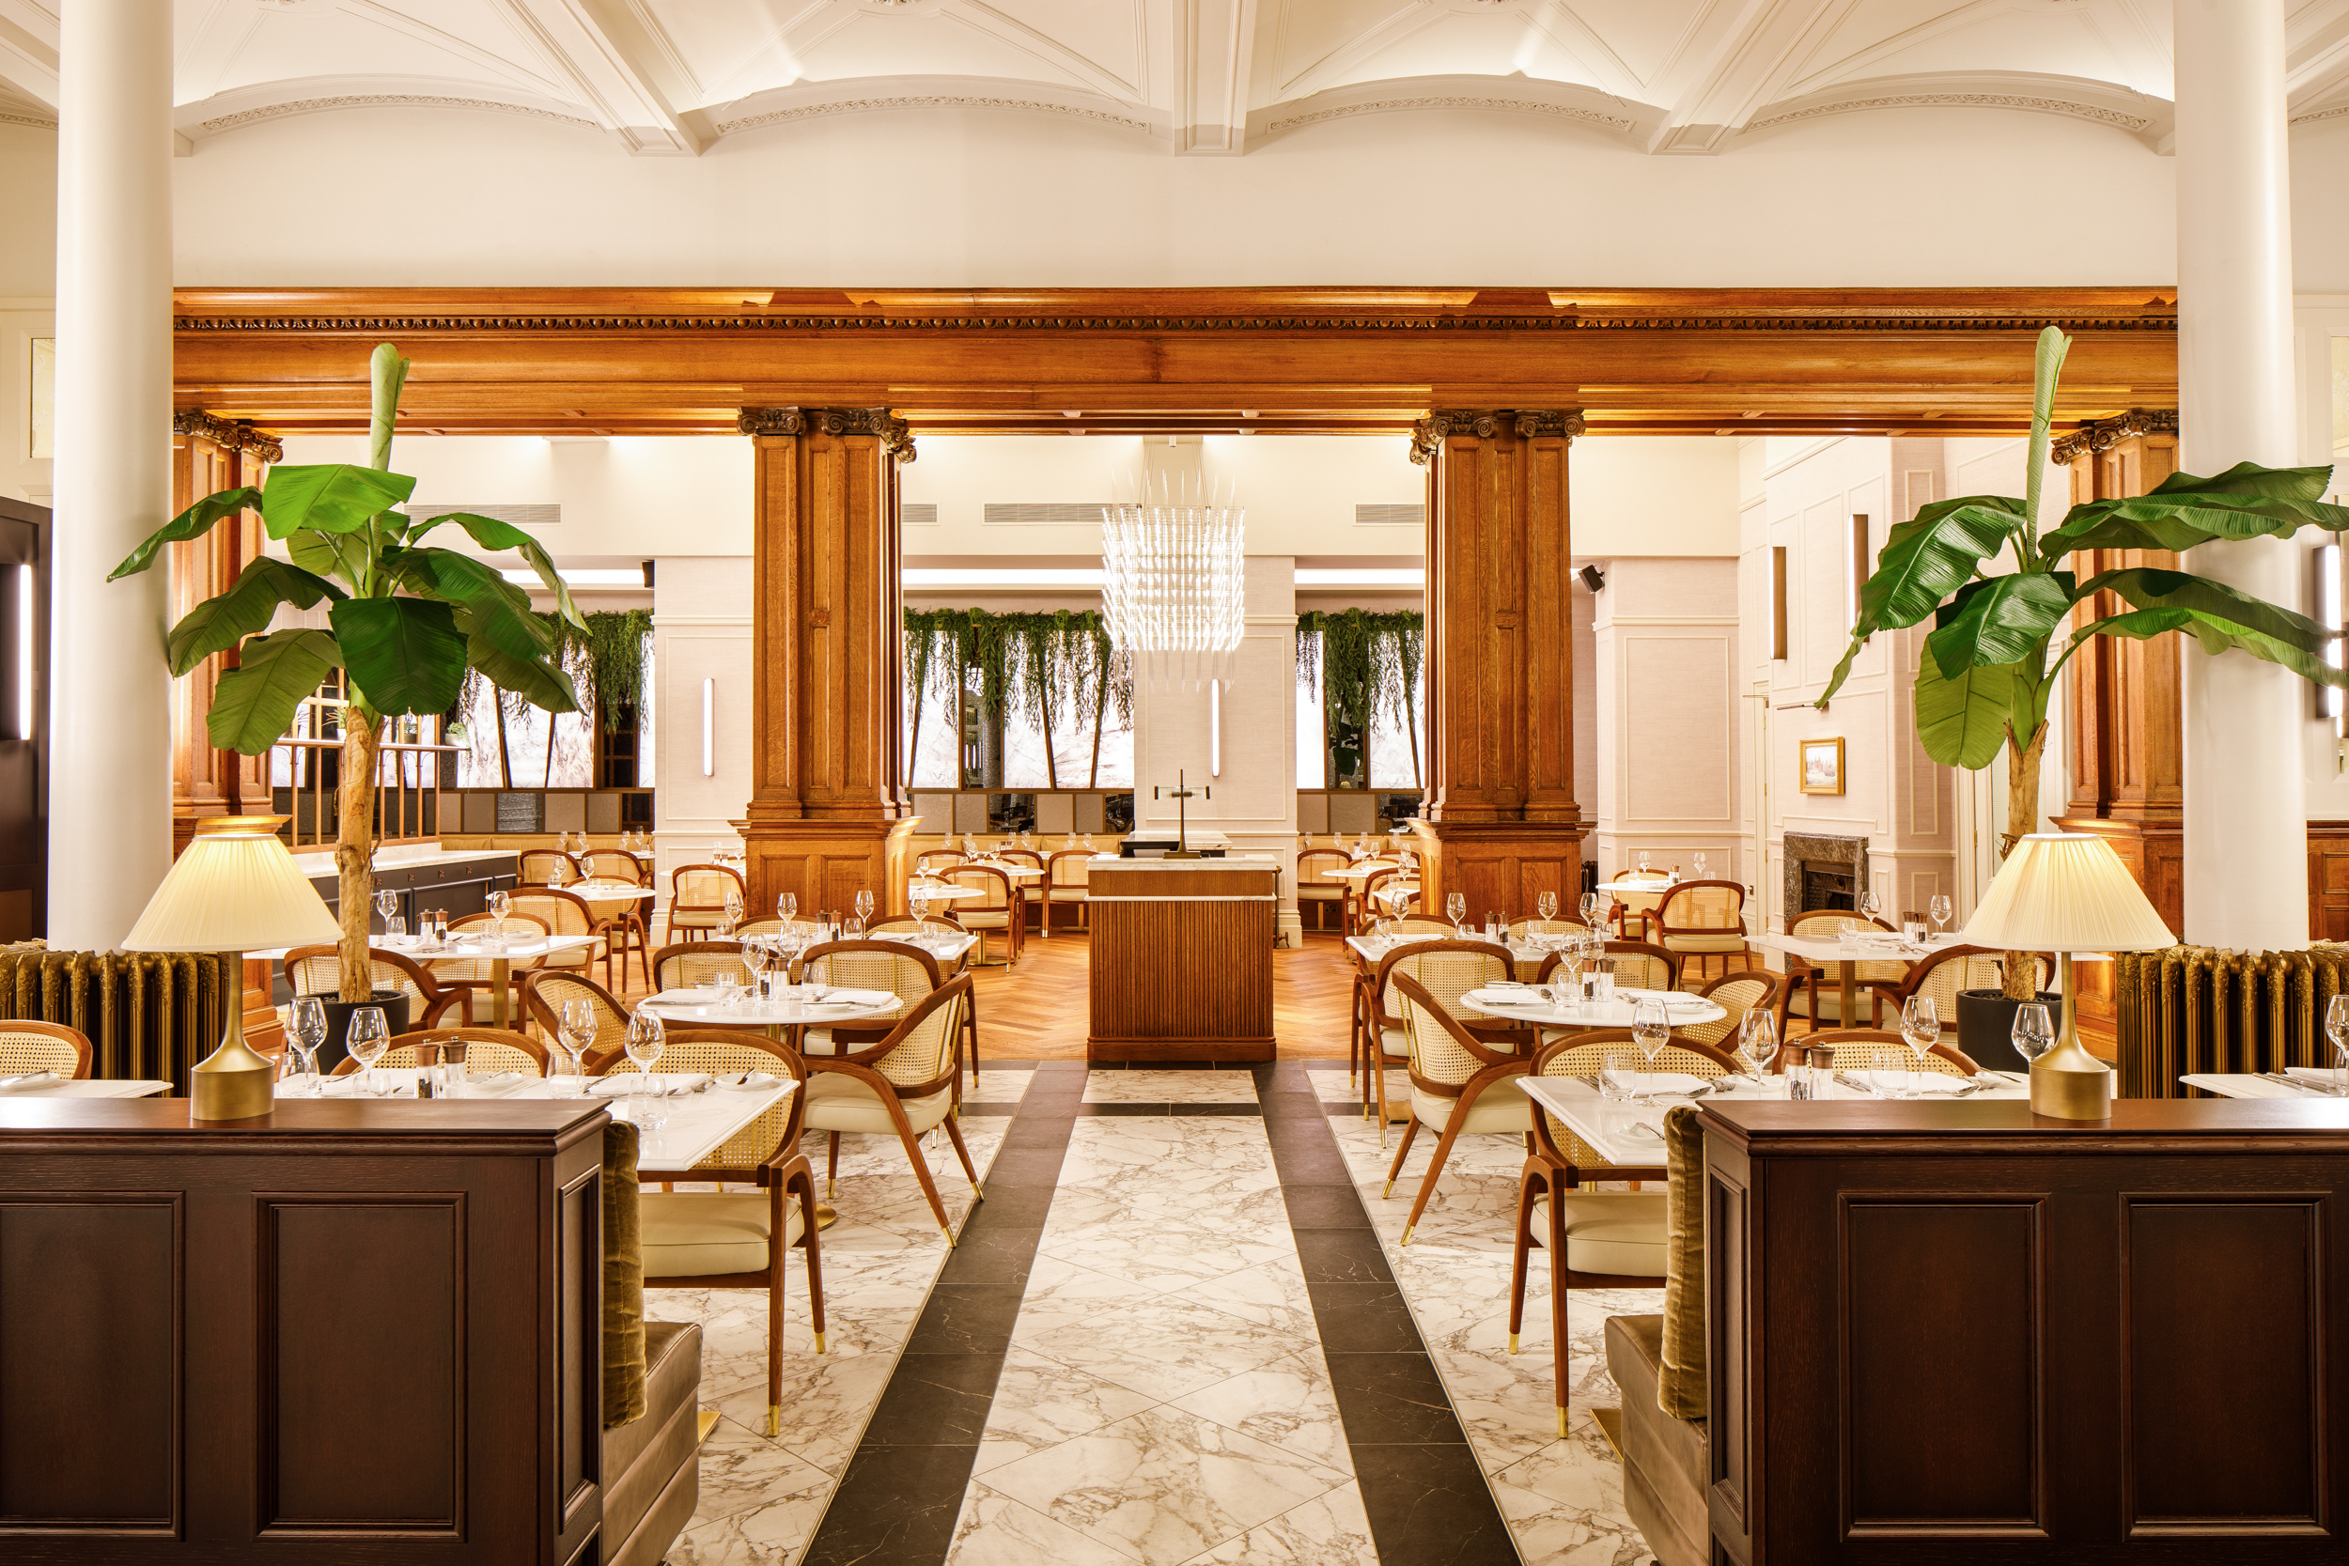
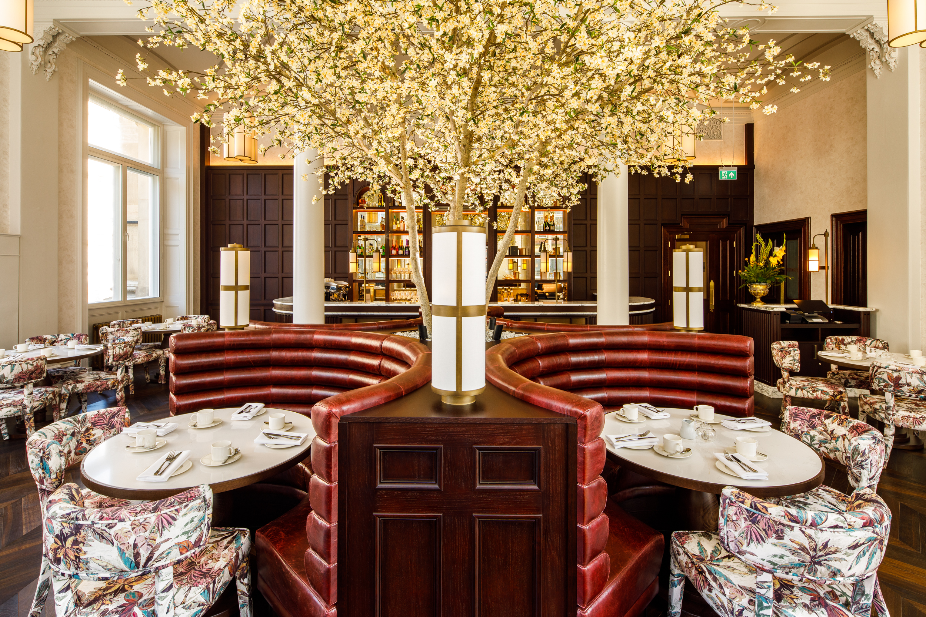
THE MUNICIPAL HOTEL LIVERPOOL - MGALLERY
Food & Beverage
Featuring 3 stunning food & beverage outlets, guests can choose from Palm Court, Seaforth Restaurant or Botanic Tearoom. Enjoy coffee and cocktails in Palm Court or the quintessential afternoon tea in Botanic complete with Municipal Champagne. Seaforth Restaurant dinner menu features dishes which reflect the cities maritime history.

Slide 4
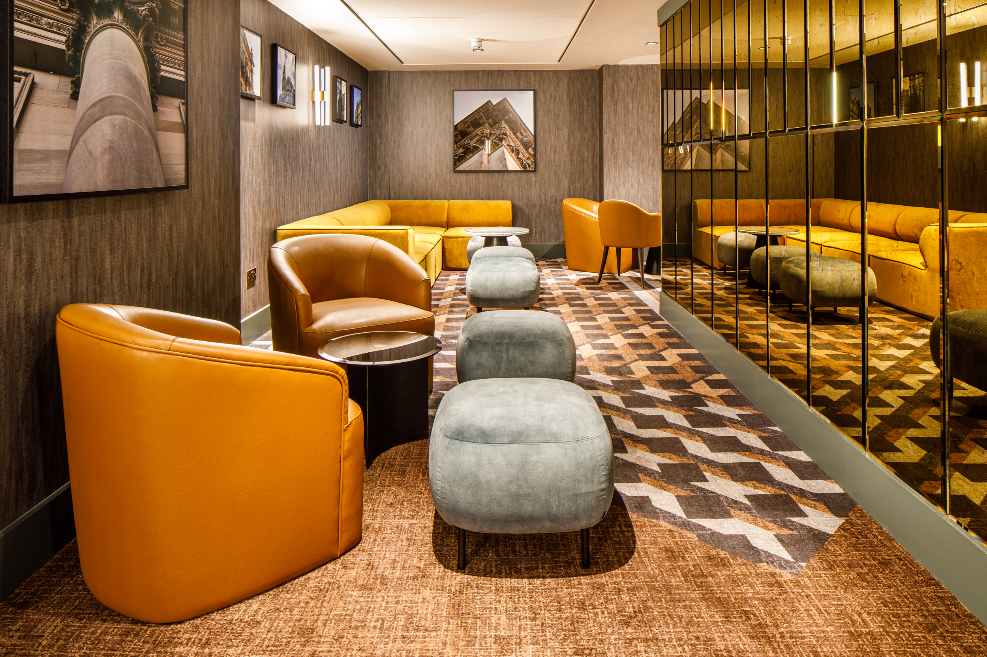
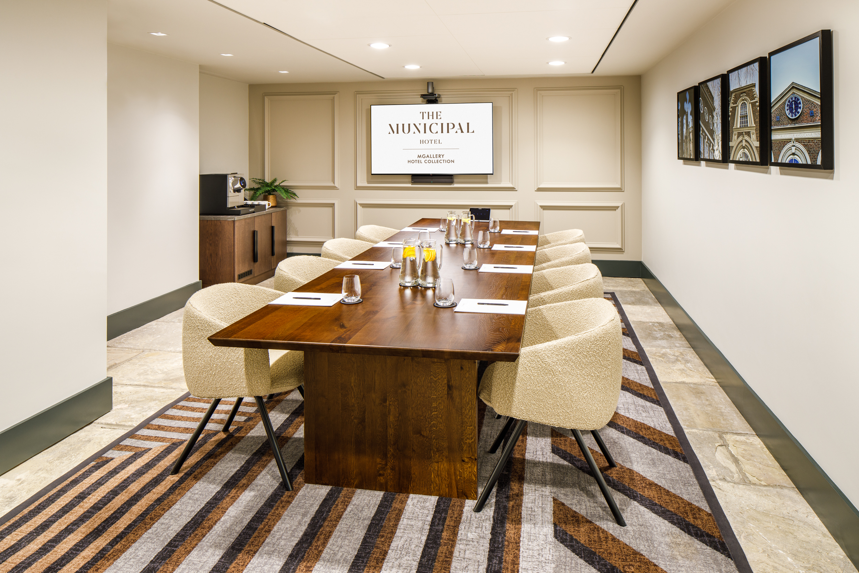
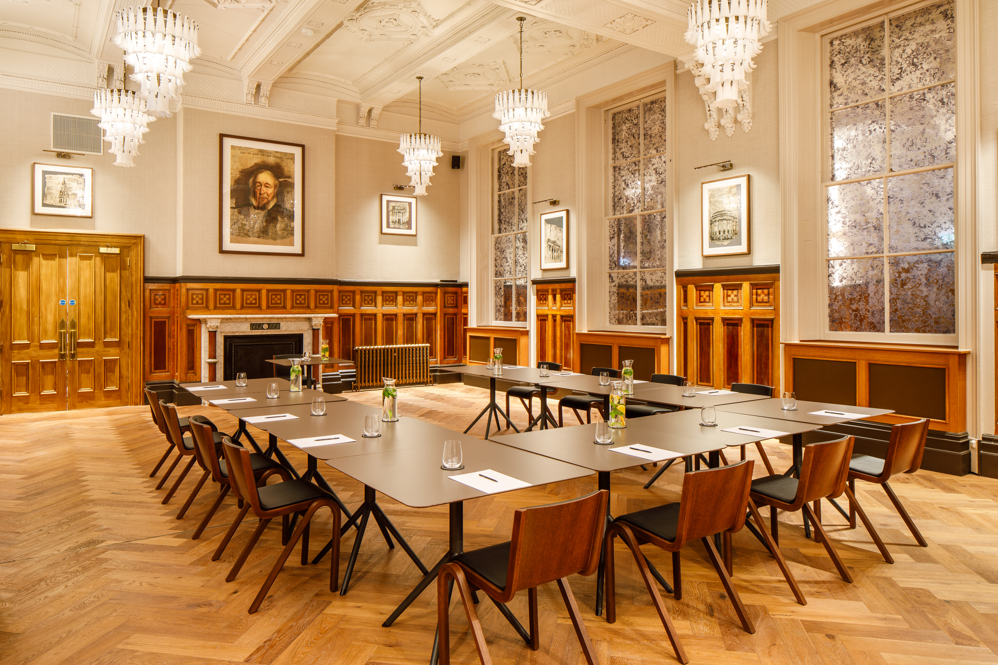
THE MUNICIPAL HOTEL LIVERPOOL - MGALLERY
Meetings made memorable
The team of event experts will welcome you in 6 unique boardrooms located in an exclusive area of the hotel plus a large private function room, perfectly positioned for events up to 80 attendees.
All meeting rooms have integrated audio visual conferencing technology.

Slide 5
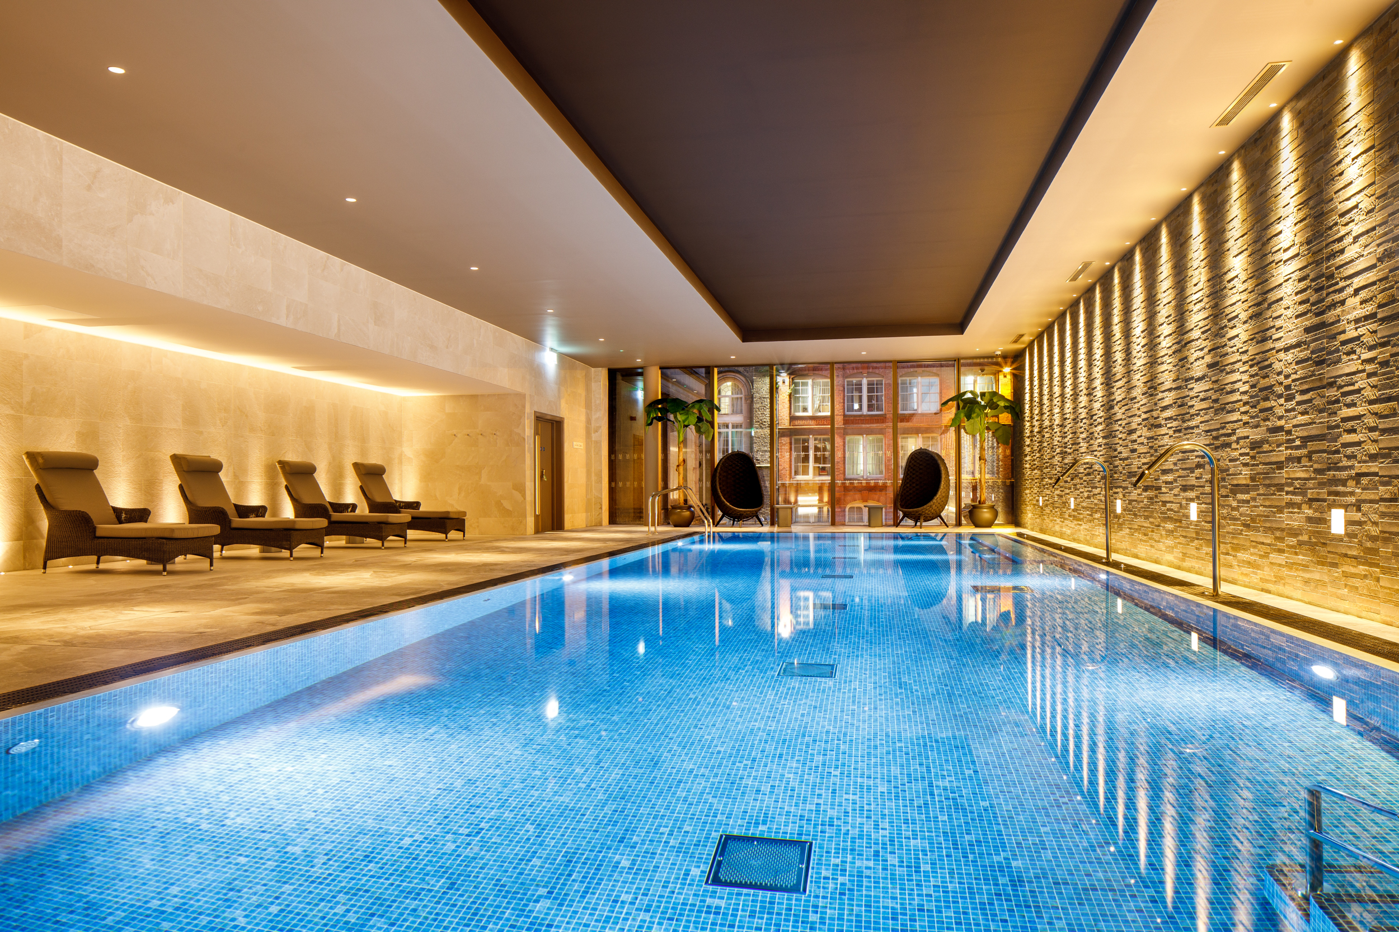
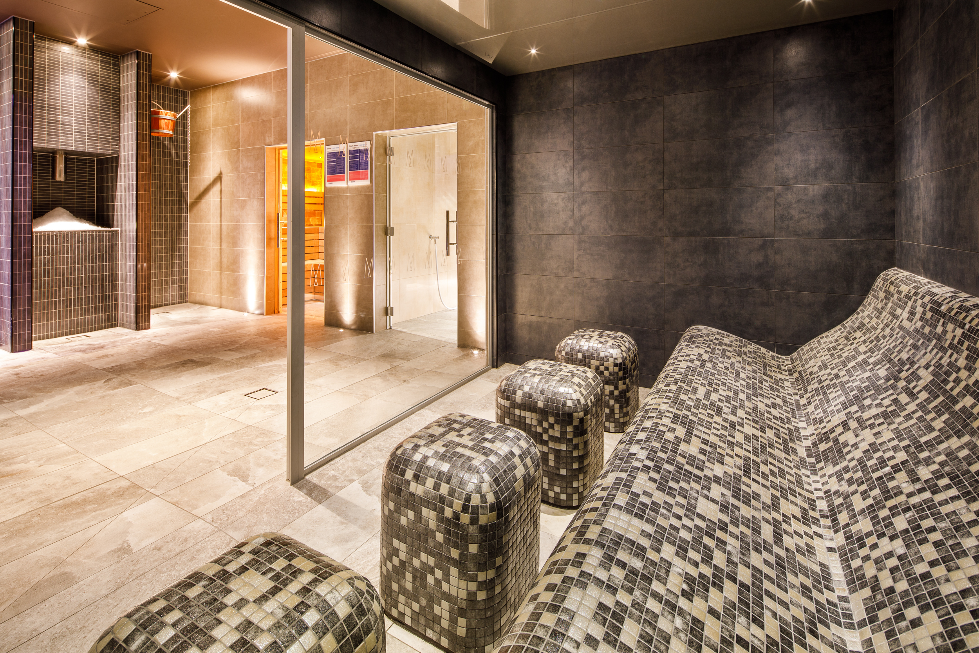
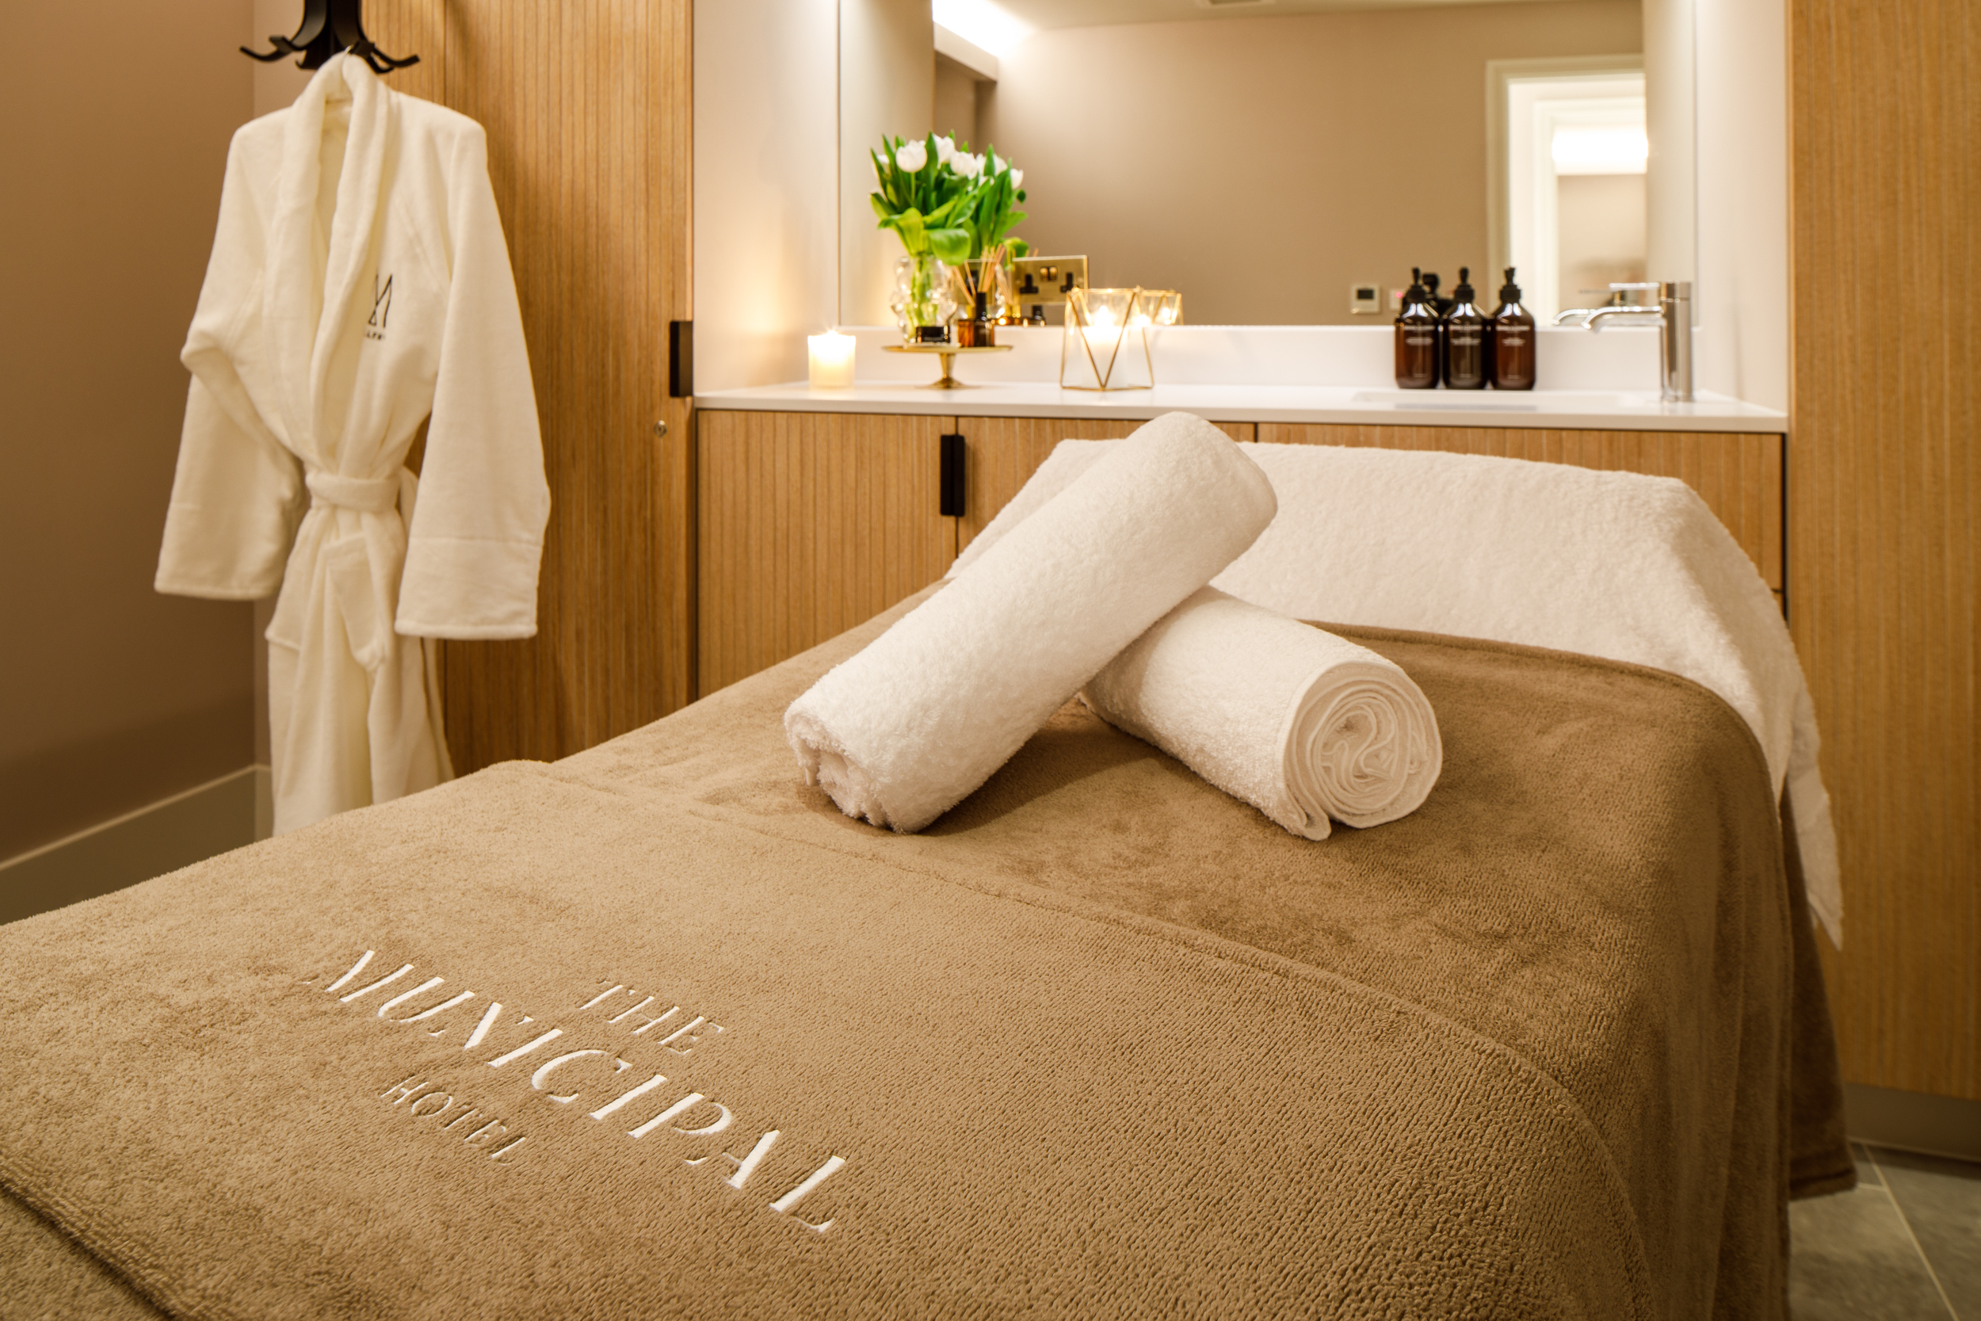
THE MUNICIPAL HOTEL LIVERPOOL - MGALLERY
Time for you
Relax in our luxurious spa, complete with 16m swimming pool, salt sauna, steam room and laconium. Take time out for you with our signature treatment with Elemis in one of our 4 treatment rooms.

Slide 6
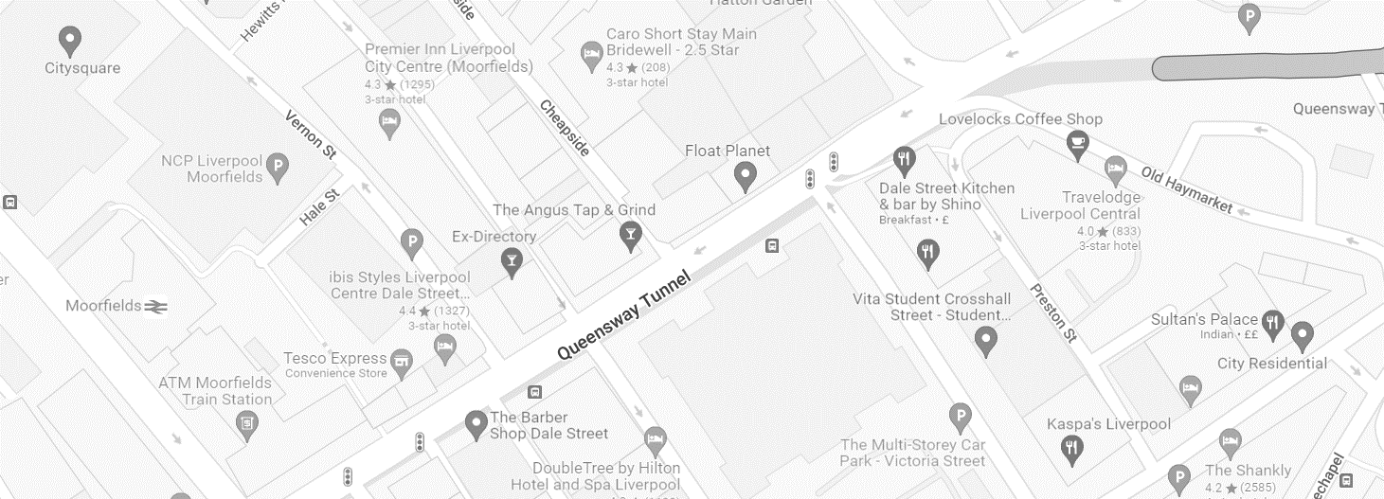
THE MUNICIPAL HOTEL LIVERPOOL - MGALLERY
The heart of Liverpool
Liverpool was once called “the New York of Europe”, boasting numerous global trade connections enabling the growth and rise of the city.
Located on Dale Street, the heart of the city's commercial area, 10 minutes from Lime Street Station. The perfect location for high-end shopping to sightseeing, dining to tourist attractions

