Slide 1


WARM
WELCOME

Slide 2
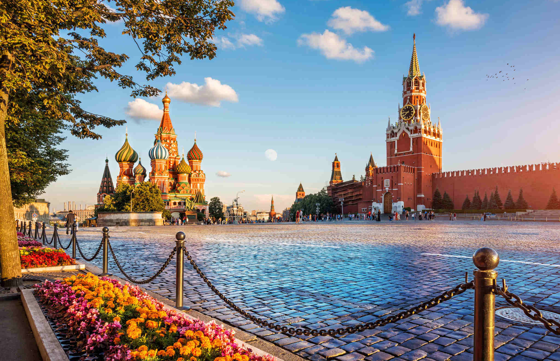
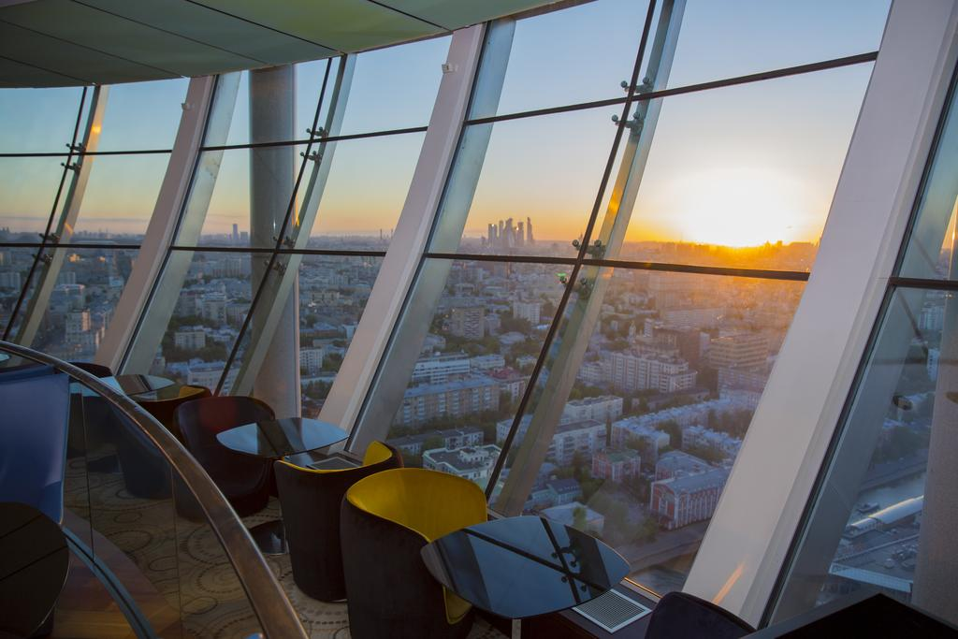
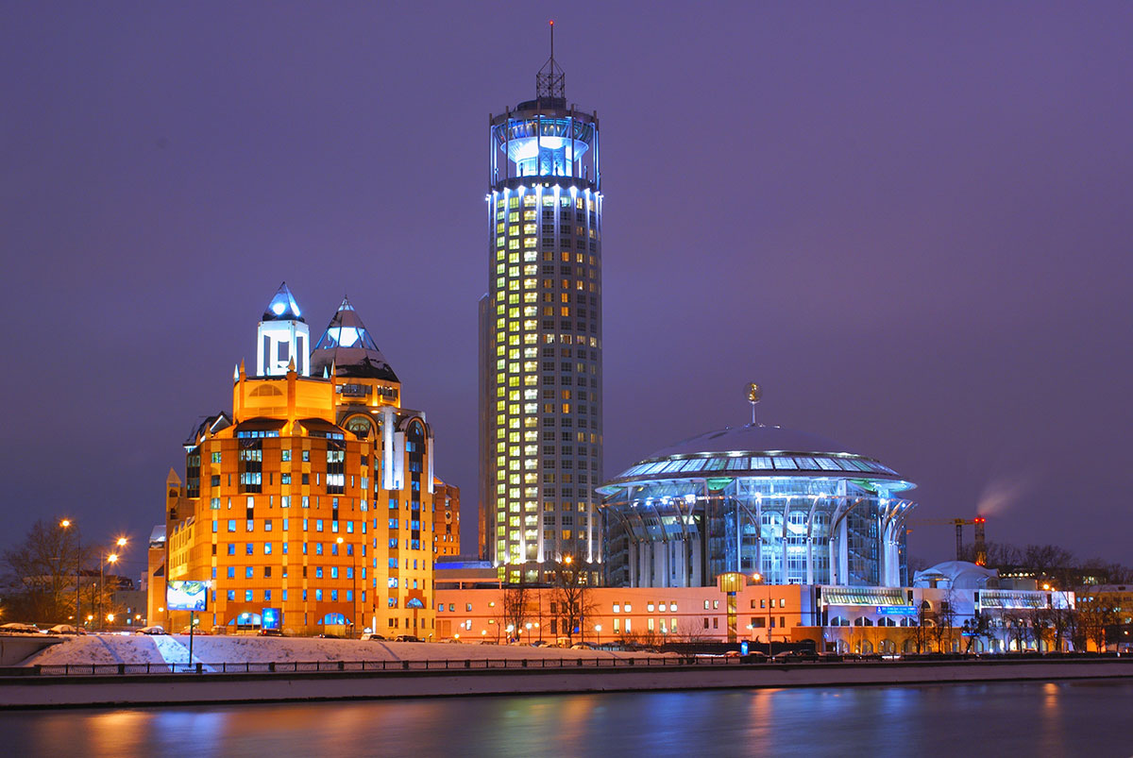

Moscow’s Landmark Hotel
An award-winning luxury Swissôtel Krasnye Holmy
is a five-star hotel and truly a Moscow‘s landmark.
Europe’s Leading
Luxury Business Hotel 2020
by World Travel Awards

Slide 3
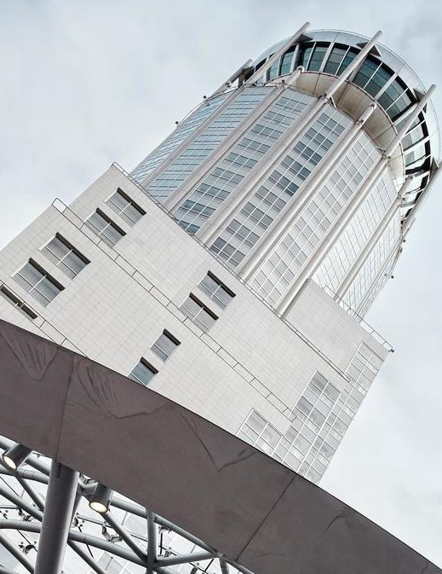
MOSCOW’S LANDMARK HOTEL
Swissotel Krasnye Holmy is situated in the heart of the Russian capital and presents to the guests the unsurpassed Swiss service and luxury combined with the most breathtaking views of the city. Situated very conveniently in Moscow’s business district and only 3km away from the Kremlin, the hotel is the ideal starting point to explore this fascinating city.
The hotel offers its guests 234 spacious guest rooms including 28 suites , one of those – a Luxurious Penthouse Suite of 272 square meters with private open air terrace on the 19th floor.
Diverse culinary options include a sumptuous breakfast buffet; an exclusive Swiss Executive Club Lounge and the beautiful Pürovel Spa & Sport round out the offer.
The trendy City Space Bar & Restaurant is the ideal place for a relaxed evening with bright sunsets and breathtaking 360-degree views of Moscow’s city center.
Business and leisure travelers will find comfort in the exclusive hotel facilities, combined with the quality, efficiency and reliability that is synonymous with Swiss hospitality.

Slide 4
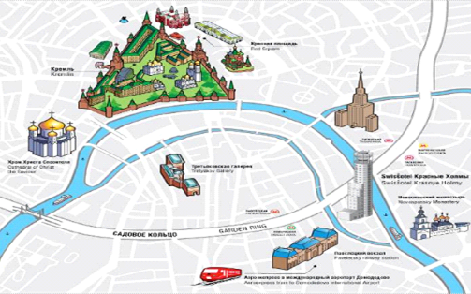
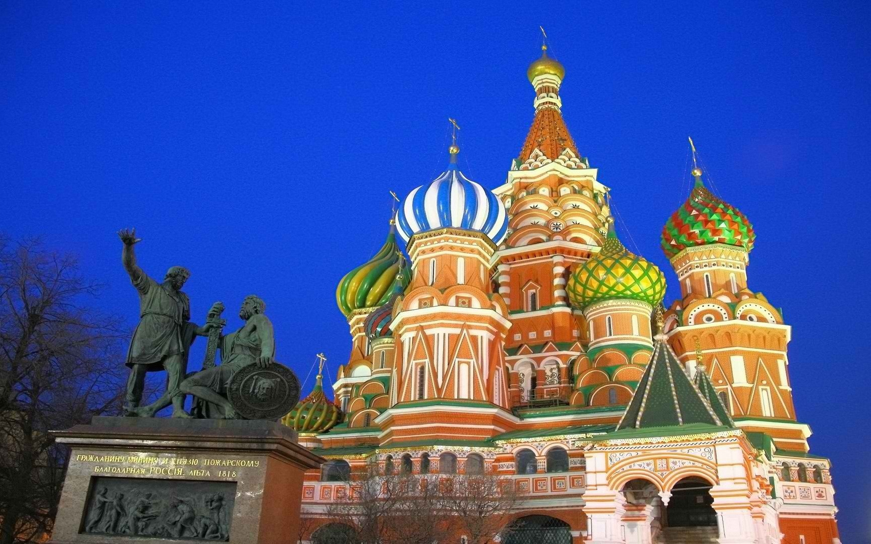
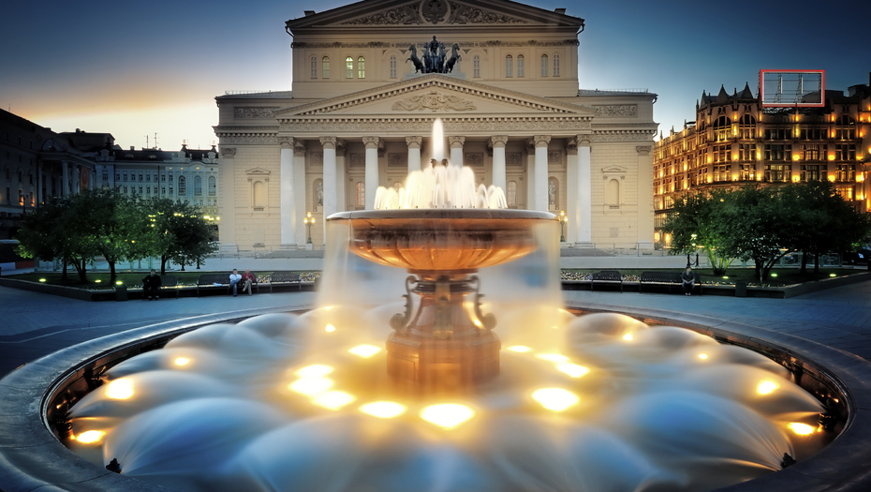
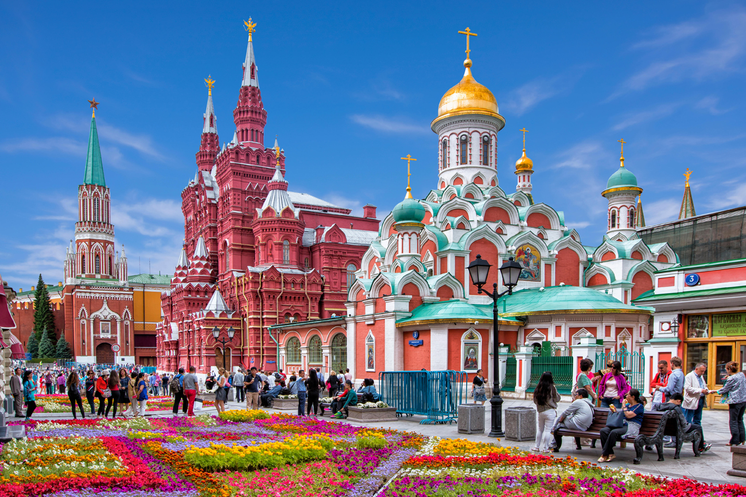
LOCATION
Central location
in a prestigious business area
Walking distance
to the Kremlin and Red Square
Distance to international airports:
  Domodedovo (DME) - 43 km. Express train from the airport to Paveletskiy railway station takes 45 minutes, the station is 700 m away from hotel.
  Sheremetyevo (SVO) – 33 km.
  Vnukovo (VKO) – 30 km.
Cultural and sightseeing highlights:
  House of Music, Bolshoi Theatre, Bachrushin Theatrical Museum, Novospassky Monastery, Tretyakov Gallery and more
Hotel offers maps with routes for runners and cyclists in the nearby areas

Slide 5
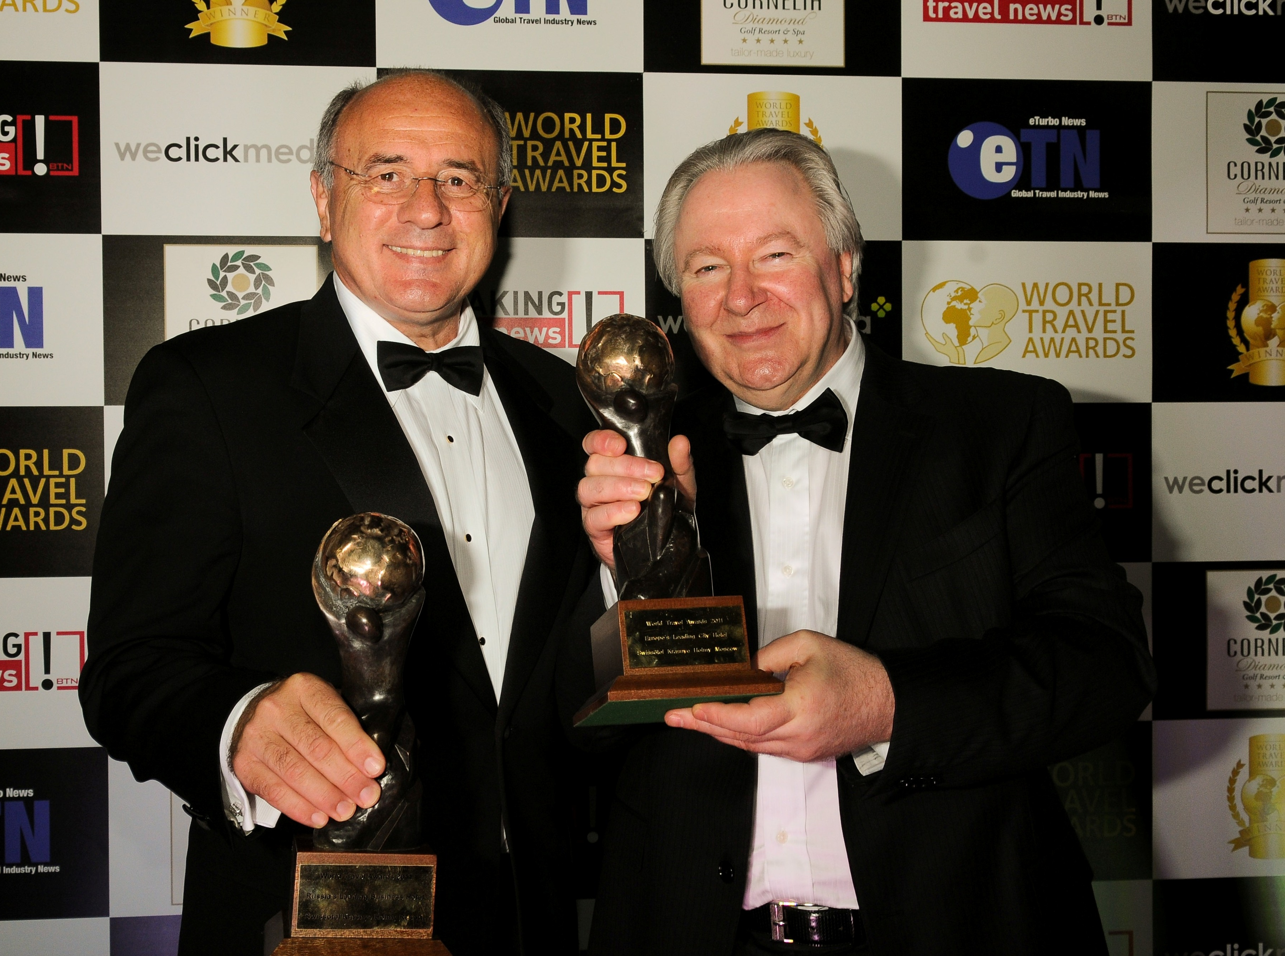
awards winner
Each year Swissotel Krasnye Holmy becomes a winner of various
prestigious awards. Over the past 5 years the hotel was recognized as:
• Europe’s Leading Luxury Business Hotel 2020 (World Travel Awards)
• Best Luxury Contemporary Hotel in Northern Europe 2020 (World Luxury Awards)
• Best Luxury City Hotel – Moscow, Customer Service Excellence Award 2020 (Resorts & Retreats Awards of Lux Life magazine)
• Best program of Corporate and social responsibility 2020 (Russian Hospitality Awards)
• Best Suite – Penthouse 2020 (Wedding Awards)
• Best Suite - Penthouse 2020 (TOP15)
  • 2020 TripAdvisor Travelers’ Choice® – 25 TOP Luxury Hotels in Russia
• Europe's Leading Luxury Business Hotel 2019 (World Travel Awards)
• Russia's Leading Luxury Business Hotel 2019 (World Travel Awards)
• World’s Leading Luxury City Hotel 2019 (World Travel Awards)
• World’s Leading Hotel Rooftop Restaurant & Bar 2019 (World Travel Awards)
• Best General Manager 2018 (Russian Hospitality Awards)
• World’s Leading Luxury City Hotel 2018 (World Travel Awards)
• World’s Leading Hotel Rooftop Restaurant & Bar 2018 (World Travel Awards)
• Outstanding Contribution to the Hospitality Industry 2018 (World Travel Awards)
• Russia’s Leading Luxury Business Hotel 2018 (World Travel Awards)
• Europe’s Leading Luxury Business Hotel 2018 (World Travel Awards)
• Russia’s Best City Hotel 2018 (International Travel Awards)
• Russia’s Best 5* Hotel 2018 (International Travel Awards)
• City Space – Bar of the year 2018 (Luxury Travel Guide Awards)
  • Best 5* Hotel for Conferences in Moscow 2018 (Russian Business Travel & MICE Award)
  • Luxury Business Hotel in Northern Europe 2018 (World Luxury Hotel Awards)
  • Best Russian City Hotel (Prime Traveler Award)
  • 2018 TripAdvisor Travelers’ Choice® – 25 TOP Luxury Hotels in Russia

Slide 6
awards winner
  • 2017 TripAdvisor Travelers’ Choice® – 25 TOP Luxury Hotels in Russia
  • 2017 TripAdvisor Travelers’ Choice® – 25 TOP Hotels for Service in Russia
  • Best Luxury Hotel Russia 2017 (Luxury Travel Guide Awards)
  • World Best Luxury Hotel & SPA 2017 (Luxury Travel Guide Awards)
  • Best Hotel Restaurant 2017 – Acapella Restaurant (Luxury Travel Guide Awards)
  • Excellence In Service 2017 (Travel & Hospitality Awards)
  • Russia’s Leading Business Hotel 2017 (World Travel Awards)
  • Russia’s Leading Luxury Business Hotel 2017 (World Travel Awards)
  • Luxury Contemporary Hotel 2017 (World Luxury Hotel Awards)
  • Luxury Rooftop View Hotel 2017 (World Luxury Hotel Awards)
  • Best Business Hotel Russia 2017 (Global Brand Magazine)
  • The Best Luxury Contemporary Hotel 2017 (World Luxury Hotel Awards)
  • The Best Luxury Rooftop View Hotel 2017 (World Luxury Hotel Awards)
• 2016 TripAdvisor Travelers’ Choice® – 25 TOP hotels in Russia
• 2016 TripAdvisor Travelers’ Choice® – 25 TOP Luxury Hotels in Russia
• 2016 TripAdvisor Travelers’ Choice® – 25 TOP Hotels for Service in Russia
• Best Hotel for Events 2016 (Sozvezdie Awards)
• Best City Hotel Moscow 2016 (LUX Hotel & Spa Awards)
• Organic Spa of the Year 2016 (LUX Hotel & Spa Awards)
• Russia’s Leading Business Hotel 2016 (World Travel Awards)
• Russia’s Leading Luxury Business Hotel 2016 (World Travel Awards)
• Luxury Hotel of the year 2016 (Luxury Travel Guide)
• Best Marketing Campaign of the year 2016 (Russian Hospitality Awards)

Slide 7
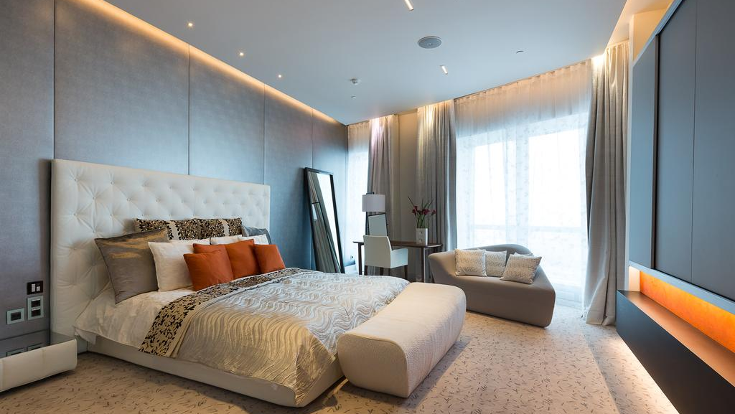
ROOMS

Slide 8
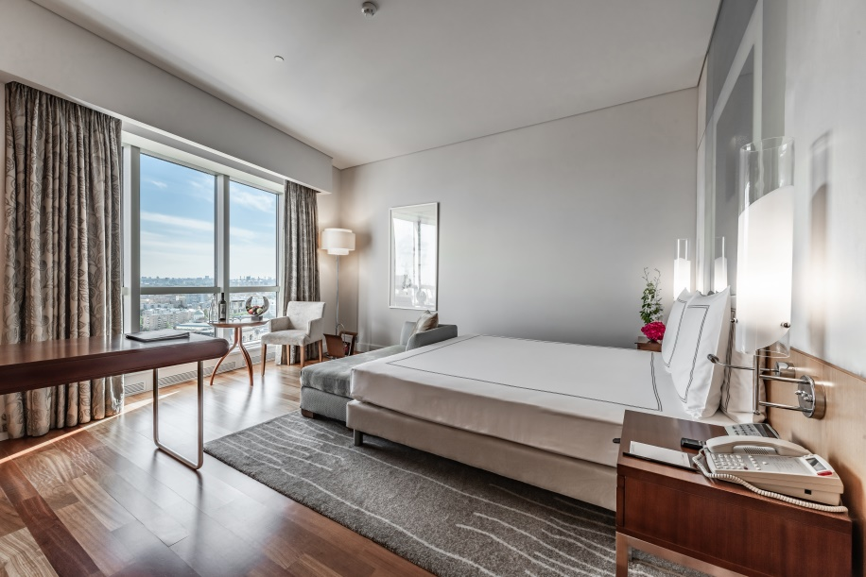
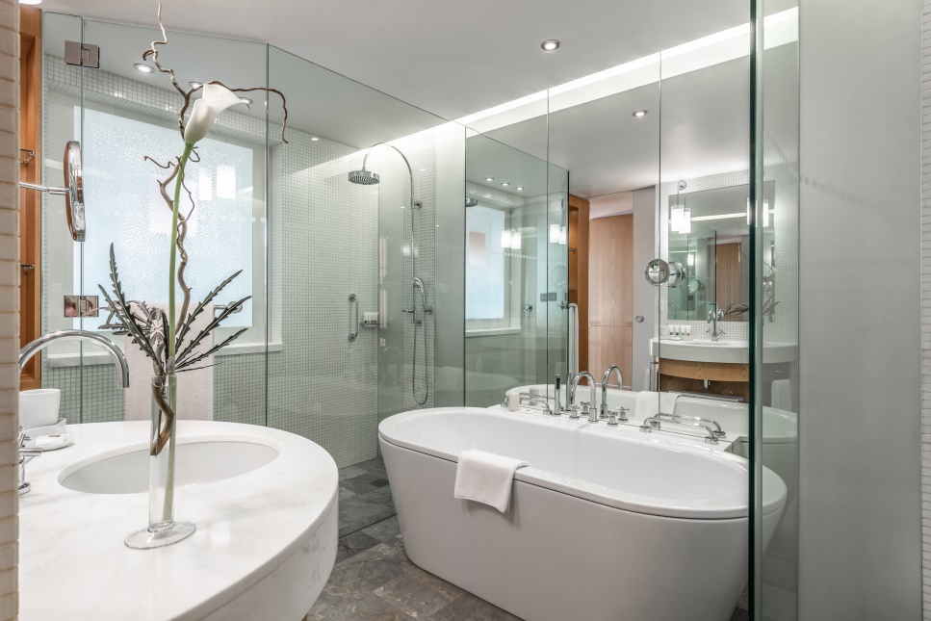
Swiss Business
Advantage Room
35-40 sq. m.
Panoramic windows with stunning views over the city
124 rooms with king-size or 2 queen-size beds
Amenities in the room: large work desk, WiFi & broadband internet, minibar, flat-screen TV and other amenities
Amenities in the bathroom: hair dryer, bathrobe, slippers, Pürovel cosmetics
Complimentary: electronic safe with the socket, Nespresso machine (tea/coffee), mineral water, access to Pürovel Spa & Sport

Slide 9
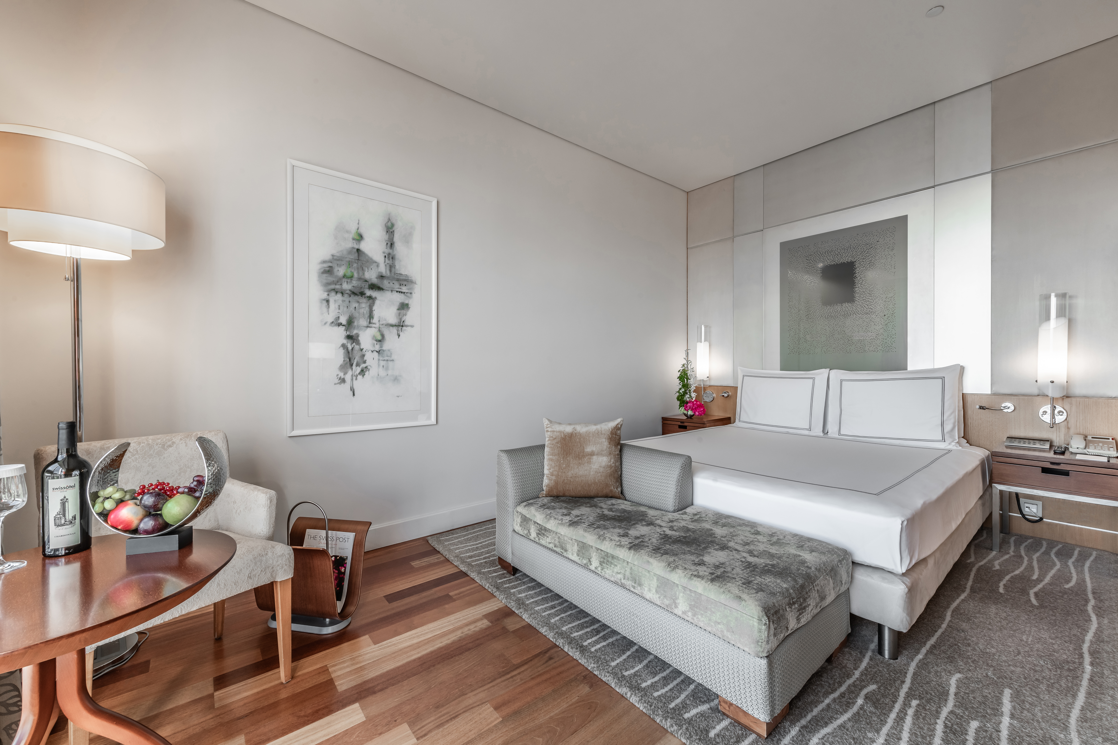
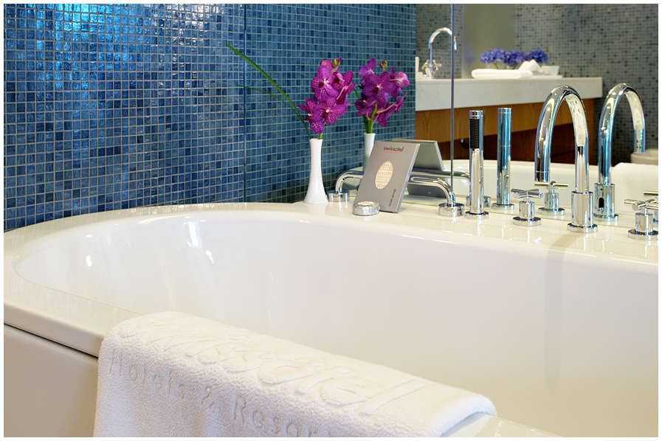
Swiss Business
EXECUTIVE CLUB Room
35-40 sq. m.
Panoramic windows with stunning views over the city
67 rooms with king-size or 2 queen-size beds
Amenities in the room: large work desk, WiFi & broadband internet, minibar, flat-screen TV and other amenities
Amenities in the bathroom: hair dryer, bathrobe, slippers, Pürovel cosmetics
Access to Swiss Executive Club Lounge (offers breakfasts, light meals, a meeting room, etc.)
Complimentary: electronic safe with the socket, Nespresso machine (tea/coffee), mineral water, access to Pürovel Spa & Sport

Slide 10
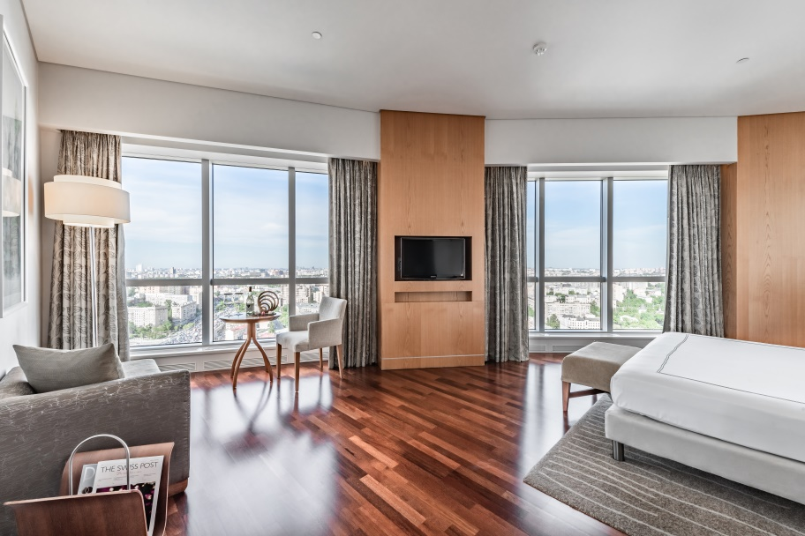
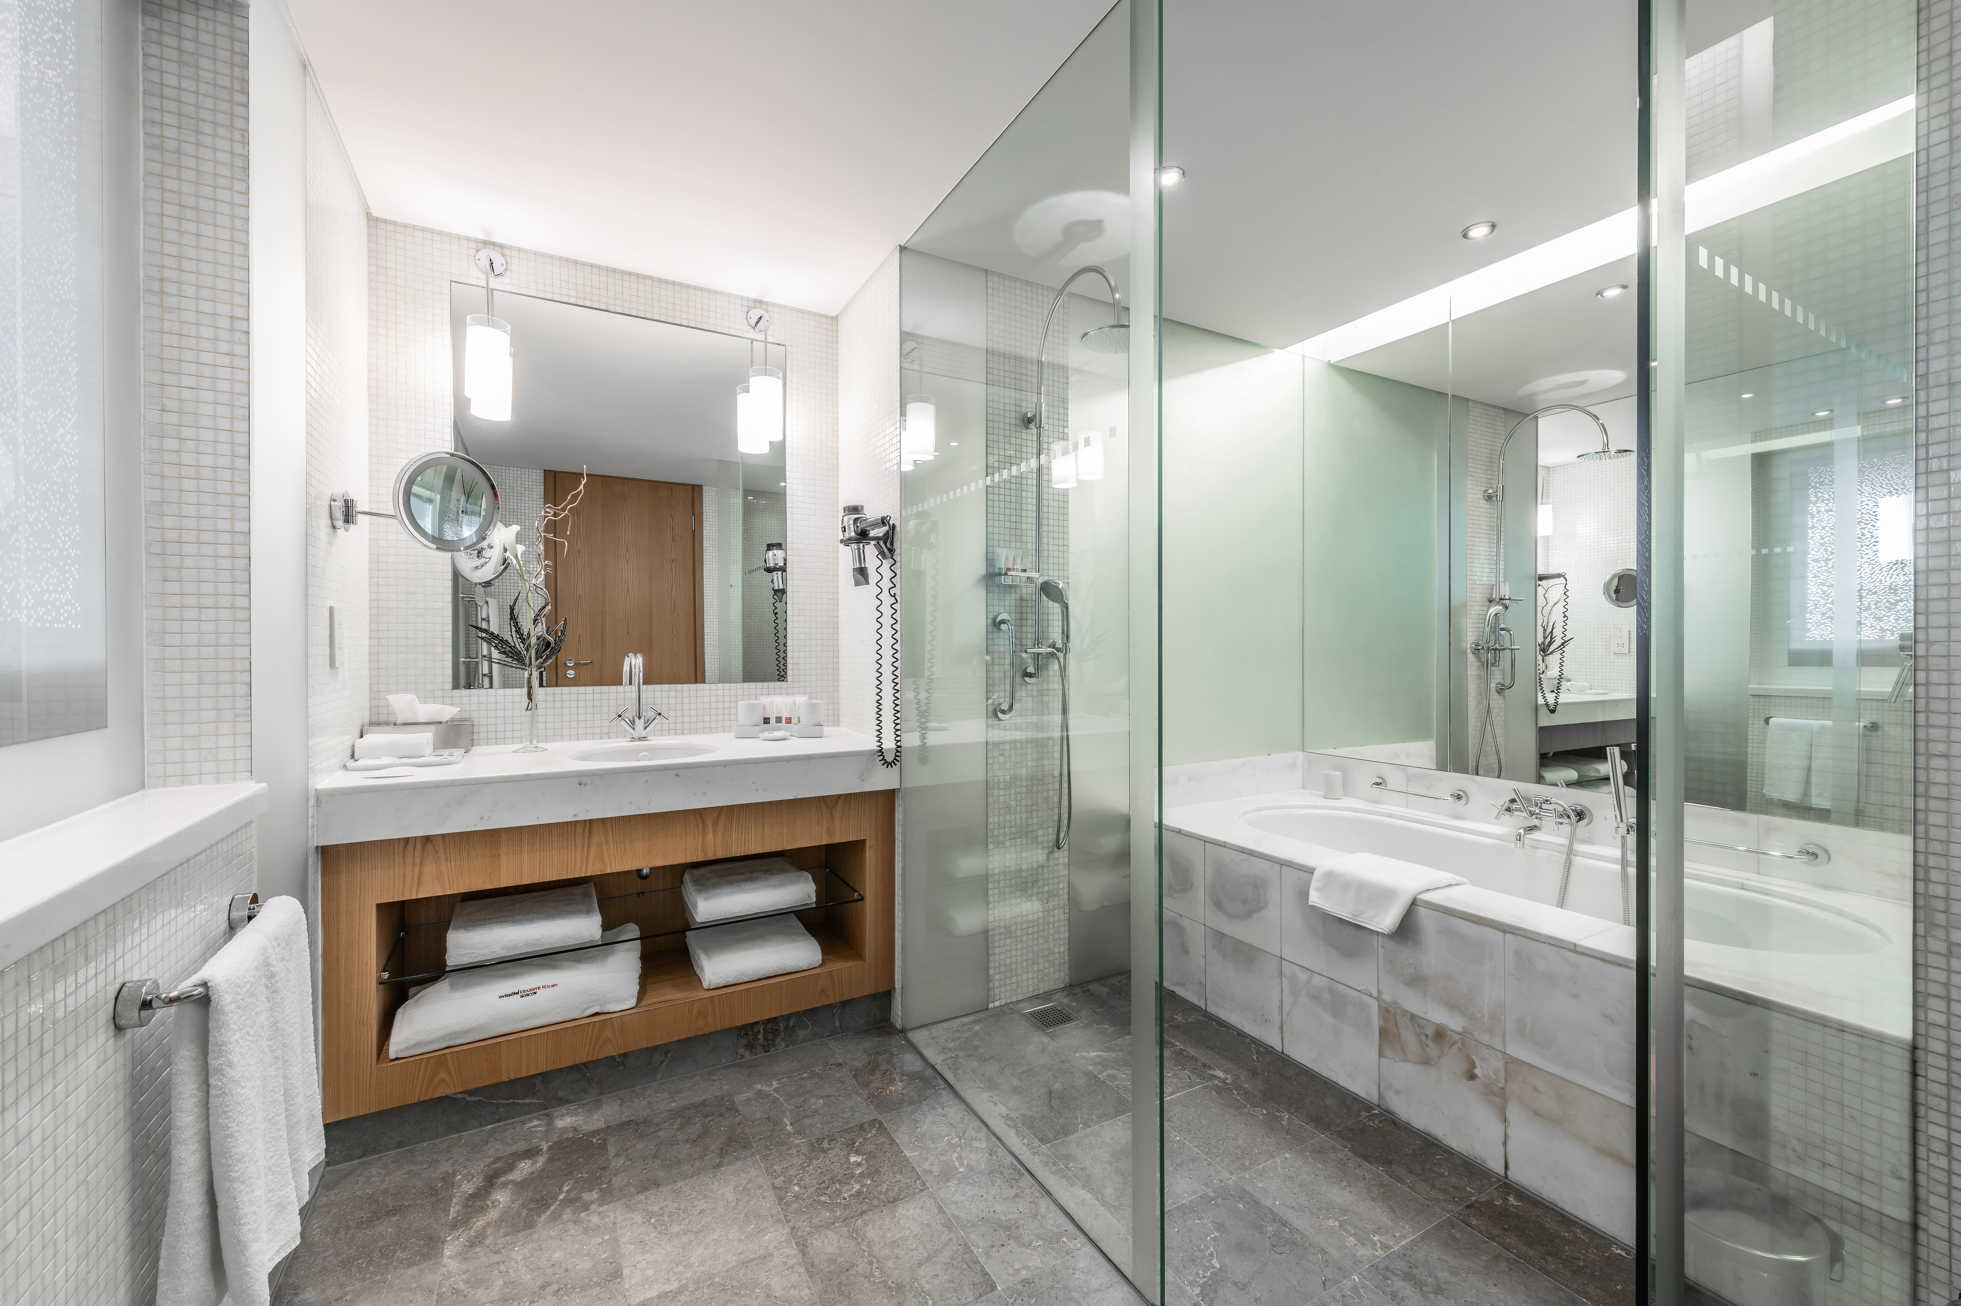
Panorama Room and suites
15 Panorama Rooms и 27 Suites
Located on the higher floors
47 – 78 sq. m.
Panoramic windows with stunning views over the city
Connecting rooms for comfortable stay with personal security or children
Amenities in the room: large work desk, WiFi & broadband internet, minibar, flat-screen TV and other amenities
Amenities in the bathroom: hair dryer, bathrobe, slippers, Pürovel cosmetics
Complimentary: electronic safe with the socket, Nespresso machine (tea/coffee), mineral water, access to Pürovel Spa & Sport, access to the Swiss Executive Club Lounge

Slide 11
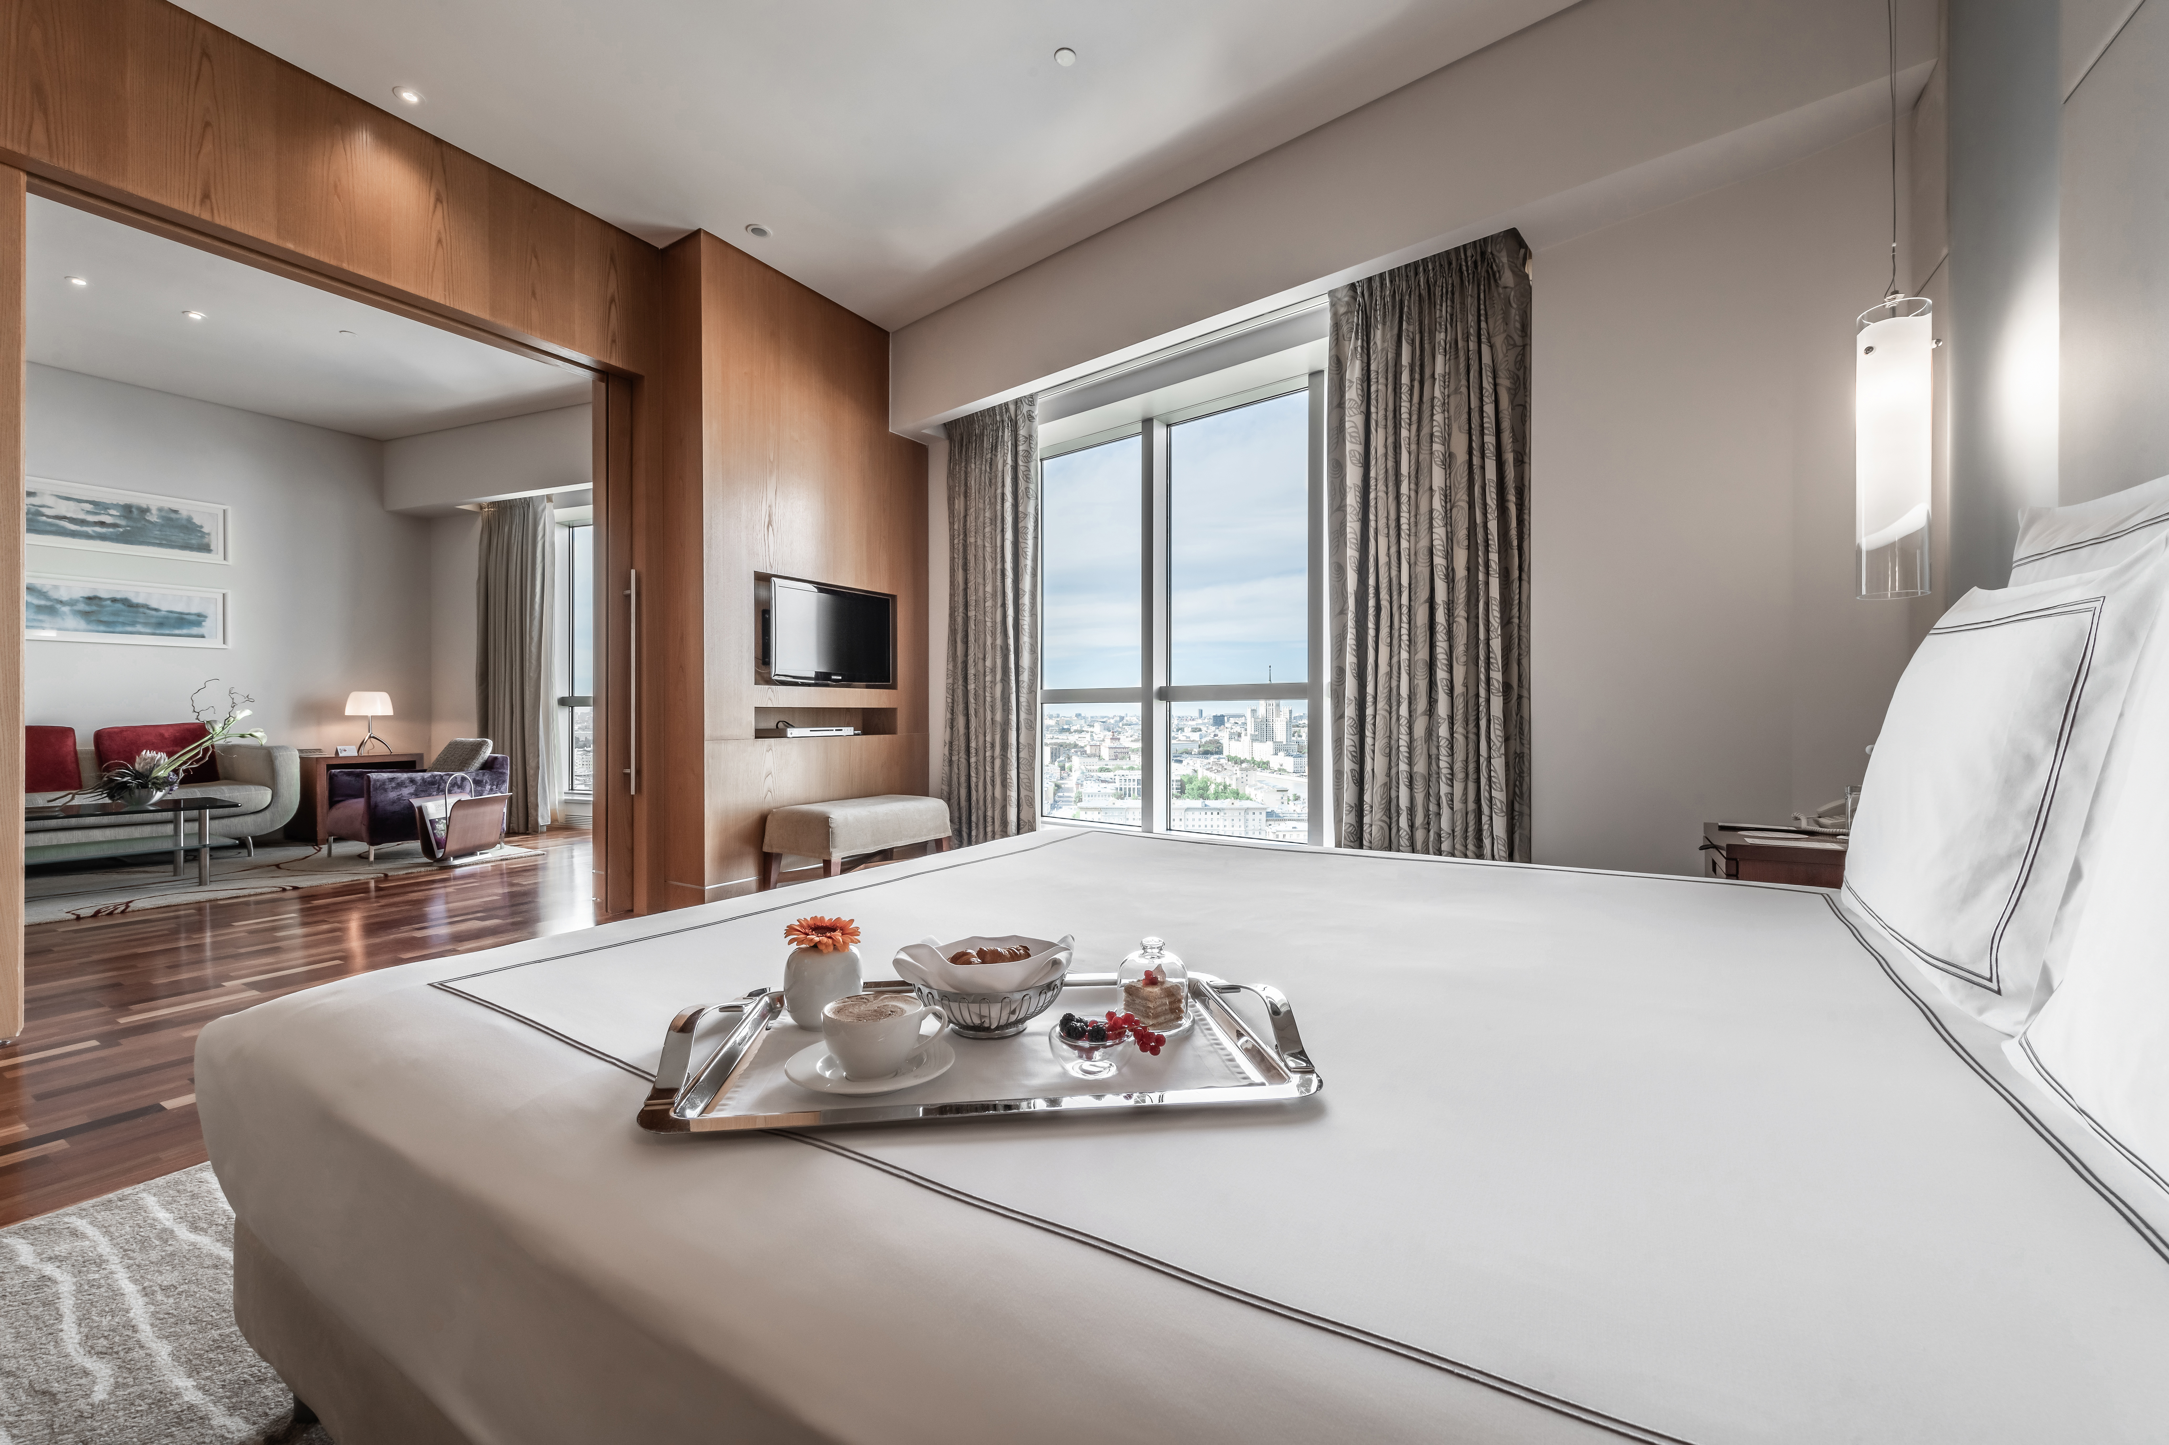
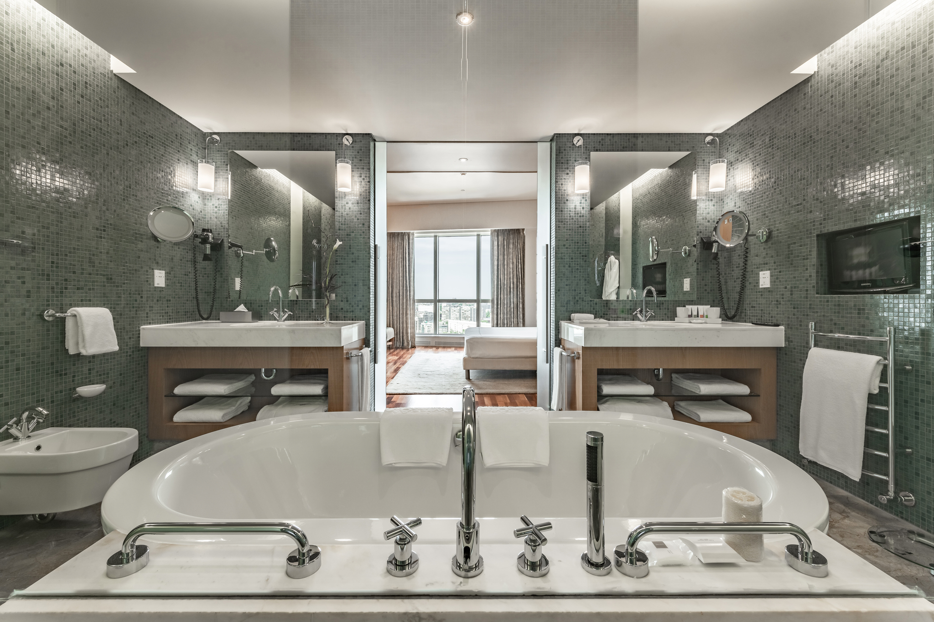
Executive & residential suites
70 and 78 sq. m.
A king-size bed in the bedroom
Wi-Fi & broadband internet
Separate bedroom, living room and spacious bathroom
Access to Swiss Executive Club Lounge
Access to spa & gym
For the dynamic executive in town on business, the elegant 70 m² Executive Suites and 78 m² Residential Suites provide all the space and technology needed to close an important deal. Located on the hotel’s top floors, these suites have a separate spacious bedroom, dining & living rooms and bathrooms with sweeping views of Moscow, providing perspective and inspiration for professional projects, large and small. You’ll also have access to the Swiss Executive Club lounge, which offers a range of special features like complimentary breakfast, beverages, snacks & newspapers.

Slide 12
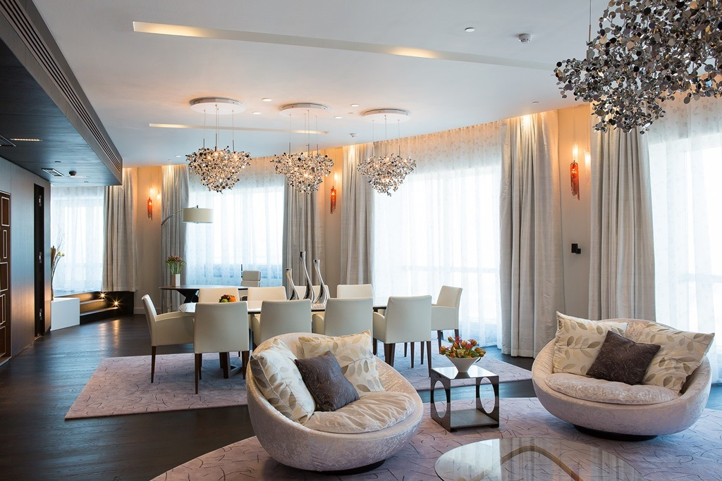
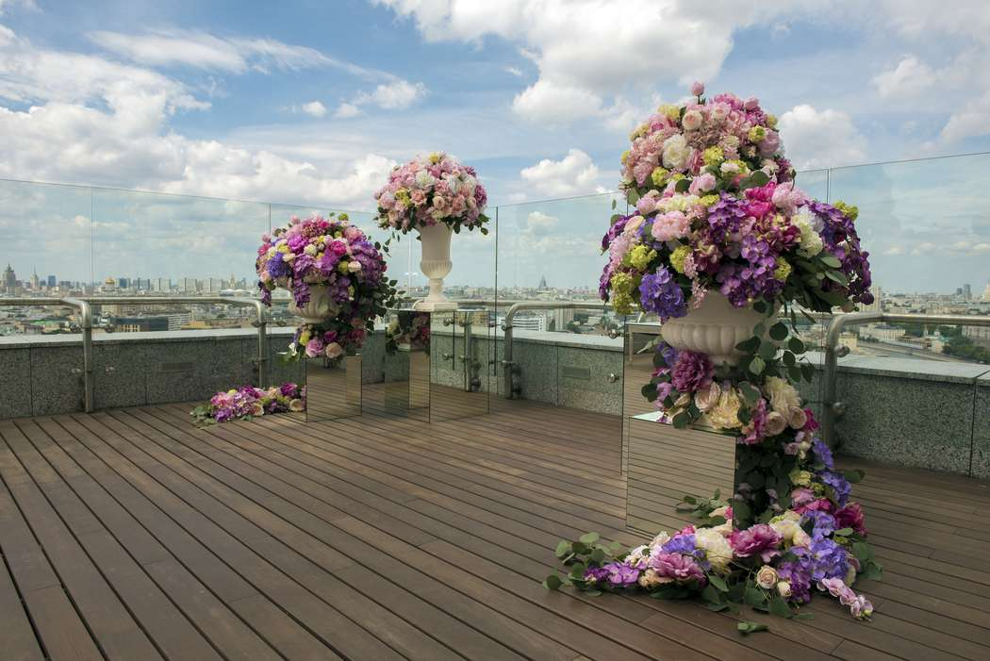
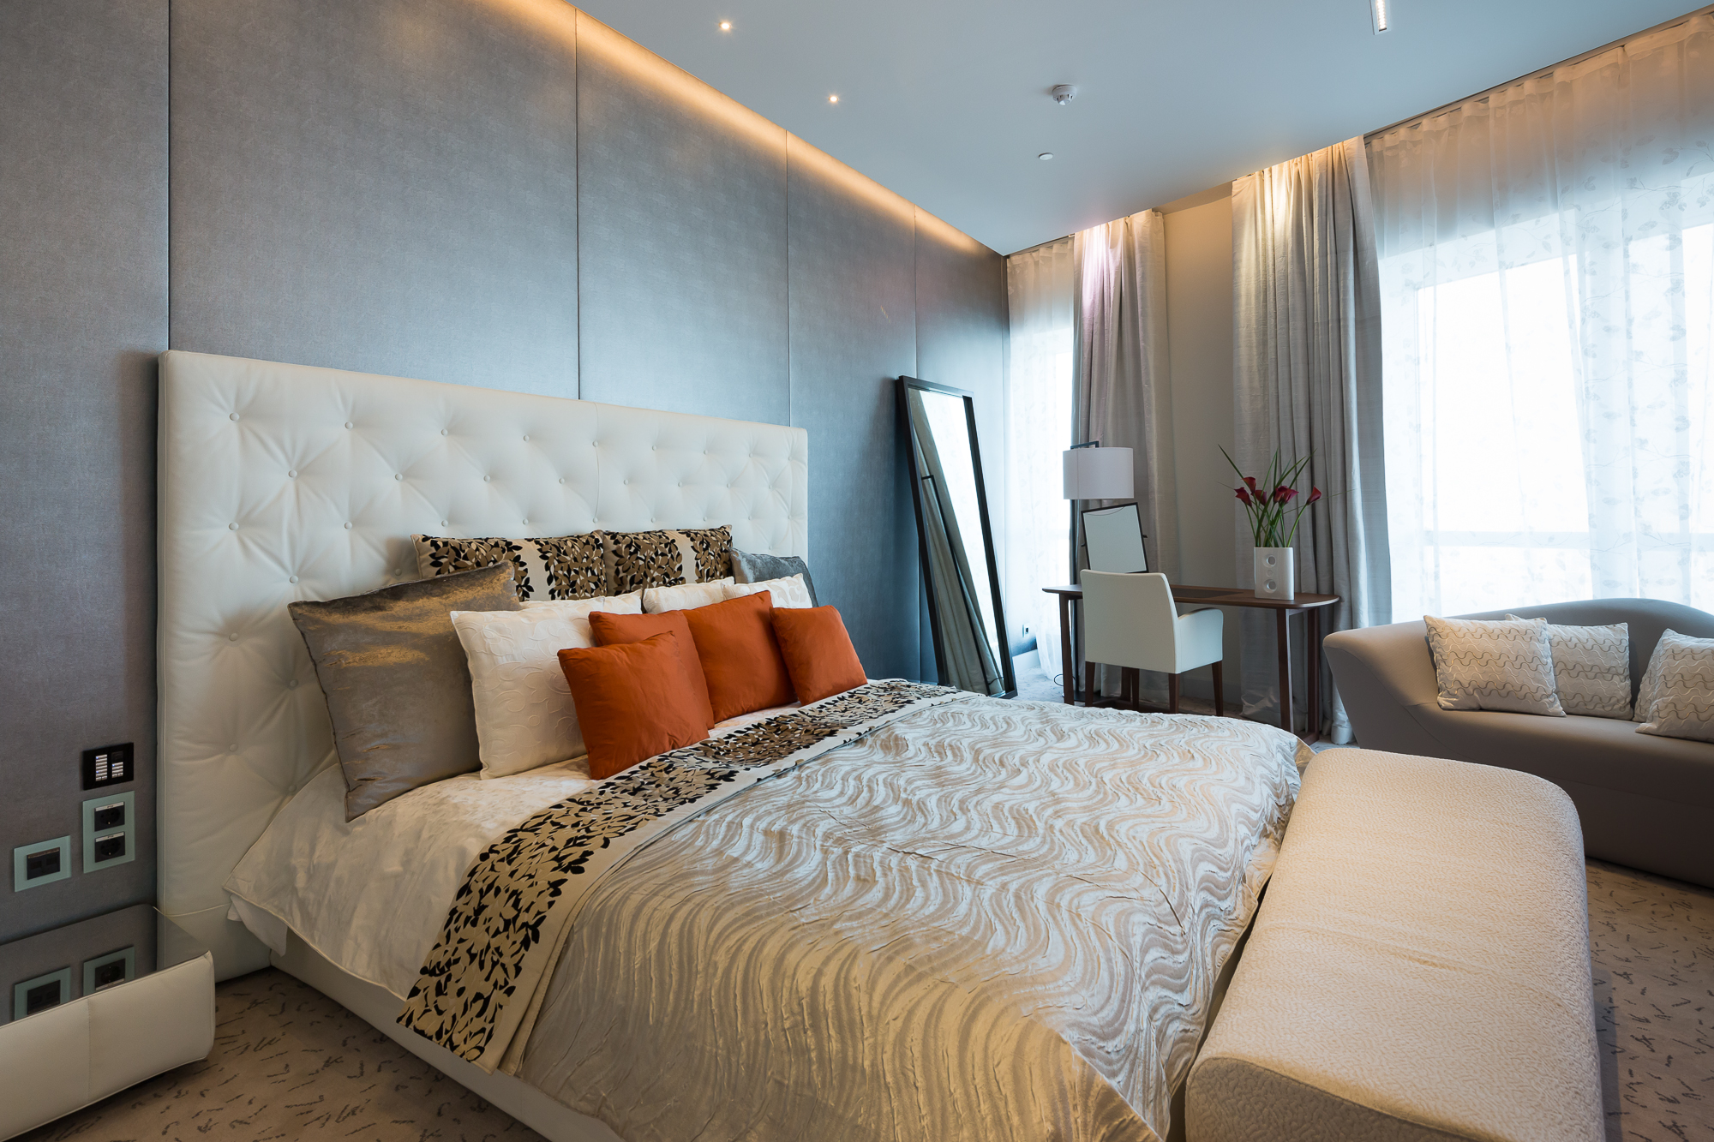
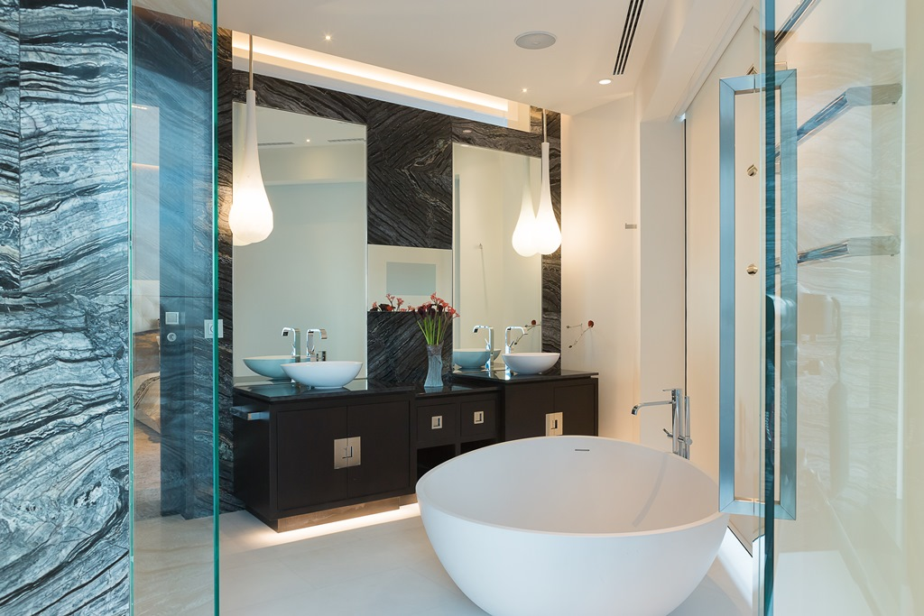
PENTHOUSE SUITE
272 sq. m. of indoor and outdoor living space.
Large multi-functional living room comprising an elegant dining room for up to 10 guests, leisure & working area
Large outdoor summer terrace that may also serve as an open-air event venue
Fully equipped kitchen
Cozy bedroom with a walk-in wardrobe
Luxurious bathroom with a modern-design bathtub, spacious walk-in shower, sauna and panoramic city views
Catering service can be provided right into Penthouse Suite

Slide 13
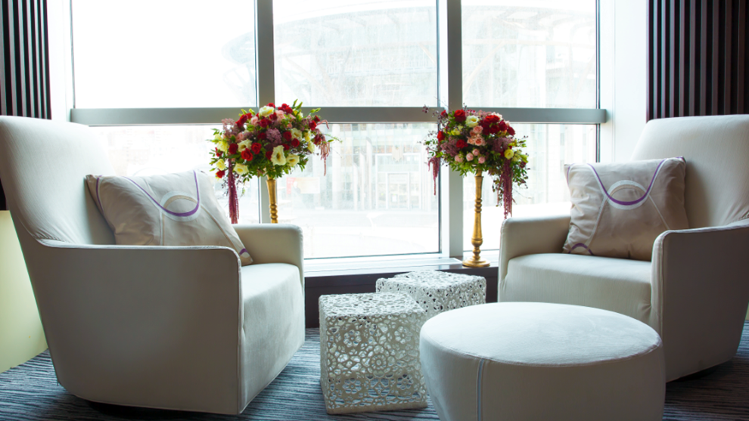
SWISS EXECUTIVE CLUB

Slide 14
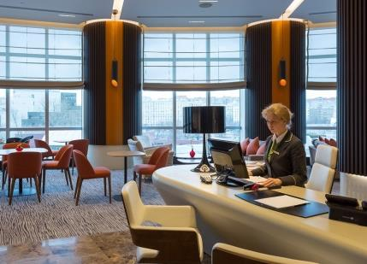
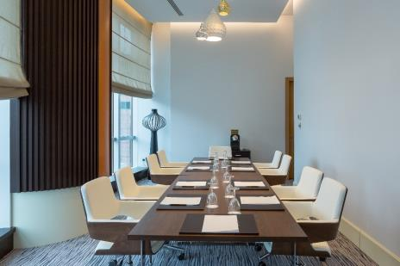
SWISS EXECUTIVE CLUB LOUNGE
For our guests staying at Swiss Business Executive Club Room, Panorama room or all categories of Suites, the following services are included into the room rate and are provided in the club lounge area, located in the 3rd floor of the hotel:
Daily breakfast, lunch and light dinner as well as light snacks during the day and evening cocktail beverages
Complimentary Internet access at two terminals at the Executive Club Lounge business corner
Color laser printer and fax machine
Boardroom for up to 10 guests is provided free of charge for business meetings for two hours per day
The spacious area with large windows and high ceilings and the quiet cozy atmosphere of Swiss Executive Club Lounge provide a perfect location for work during the day, and for the evening relaxation afterwards.

Slide 15
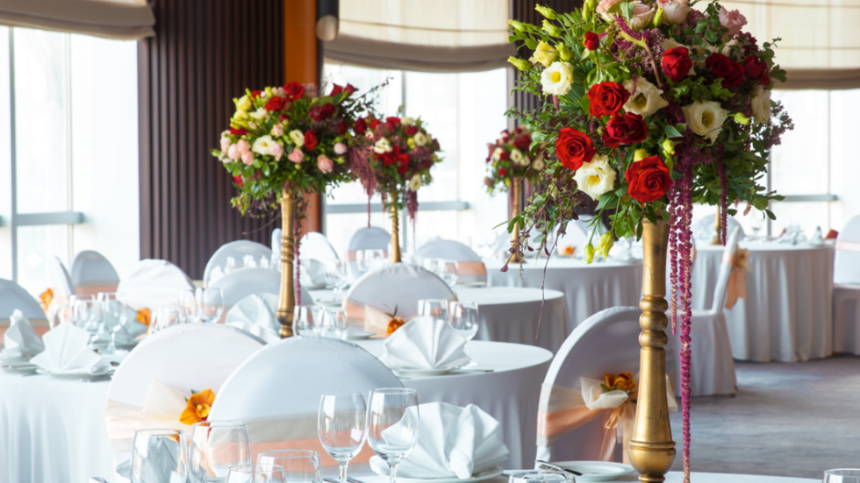
CONFERENCE & BANQUETING

Slide 16
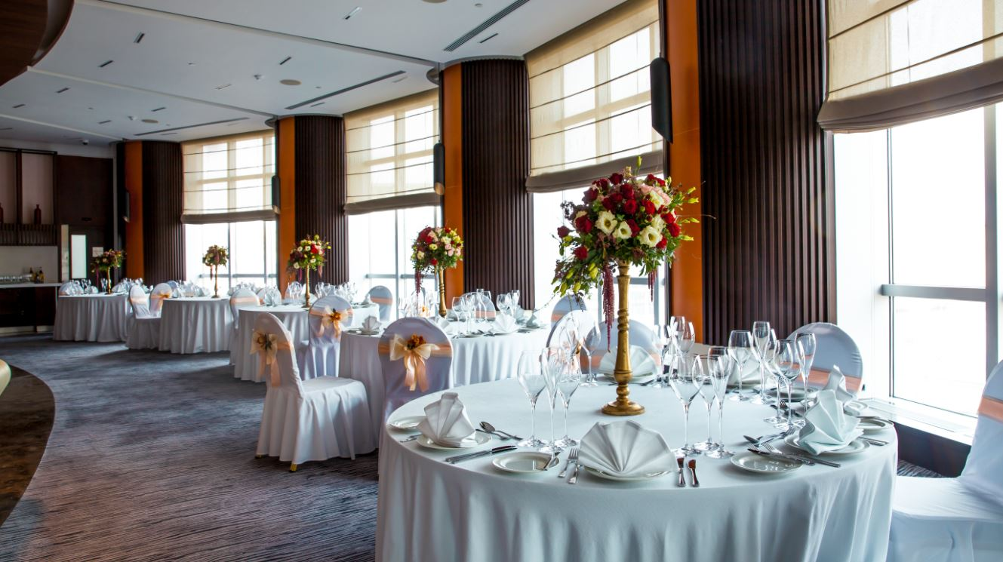
Conference & banqueting
Swissotel Krasnye Holmy Moscow offers technologically advanced conference and banqueting facilities for cocktail parties, video conferences, product launches, dinners, gala events and weddings.
11 beautiful well-appointed ballrooms and meeting rooms.
A column-free ballroom Zurich features offers a great opportunity for different kinds of events: conferences, seminars, trainings, presentations and private celebrations.
A unique ballroom Davos, located on the 29th floor of the hotel offers breathtaking panoramic views of Moscow.
A spacious outside parking has a convenient access from the Garden Ring.

Slide 17
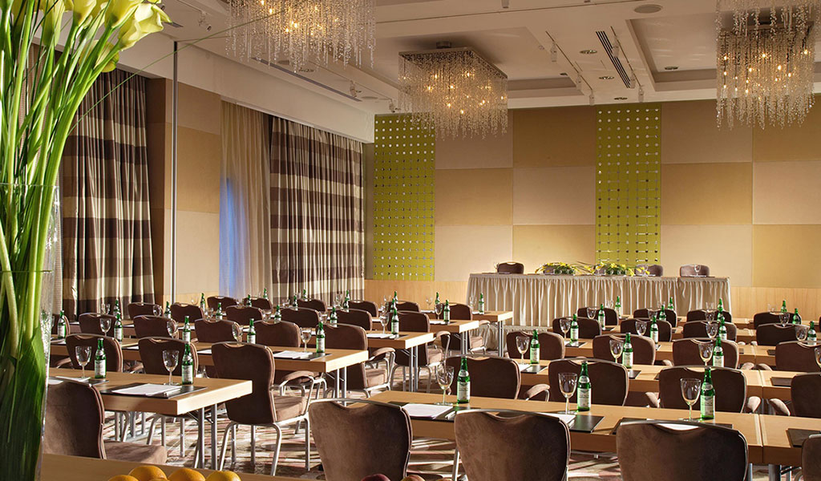
Zurich ballroom
Zurich Ballroom
The spacious Zurich ballroom (166 sq. m.) is located on the ground floor of the hotel. This column-free ballroom features natural daylight and offers a great opportunity for different kinds of events: conferences, seminars, trainings, presentations and private celebrations. The Zurich can be divided into two separate meeting rooms, Zurich I (64 sq. m.) and Zurich II (102 sq. m.)

Slide 18
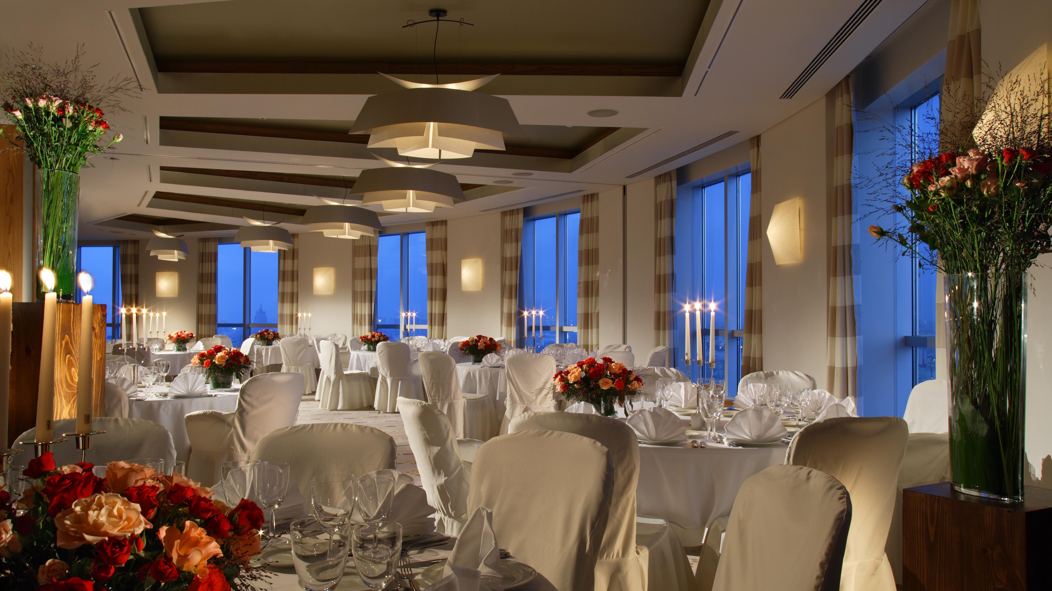
davos ballroom ON THE 29TH FLOOR
Davos Ballroom on the 29th floor
Surprise your guests with an event high above Moscow. The Davos ballroom, located on the 29th floor of the hotel, has a unique semicircular shape and offers breathtaking views of Moscow: from the Novospassky monastery to the Red Square and Kremlin. This fully equipped ballroom is an ideal choice for conferences, presentations and private events. The ballroom can be divided into two separate meeting rooms with the Davos I (74 sq. m.) and the Davos II (75 sq. m.)

Slide 19
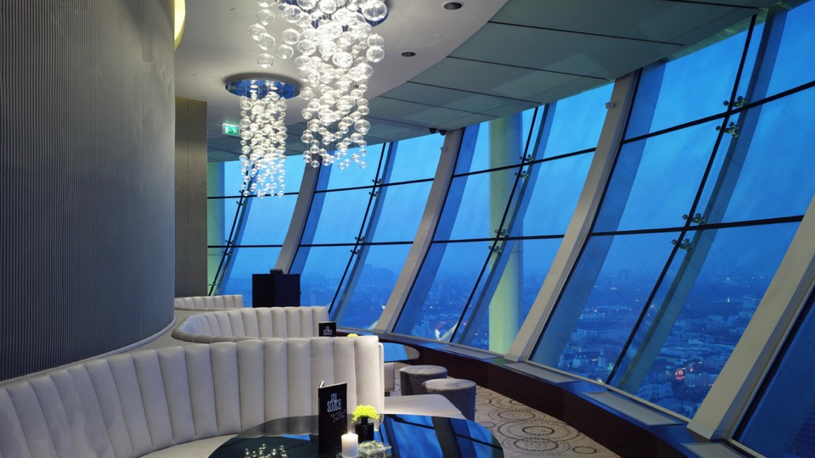
RESTAURANTS
&
BARS

Slide 20
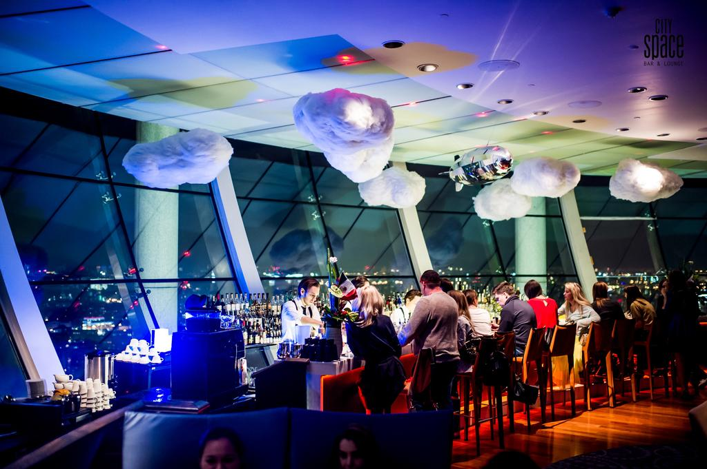
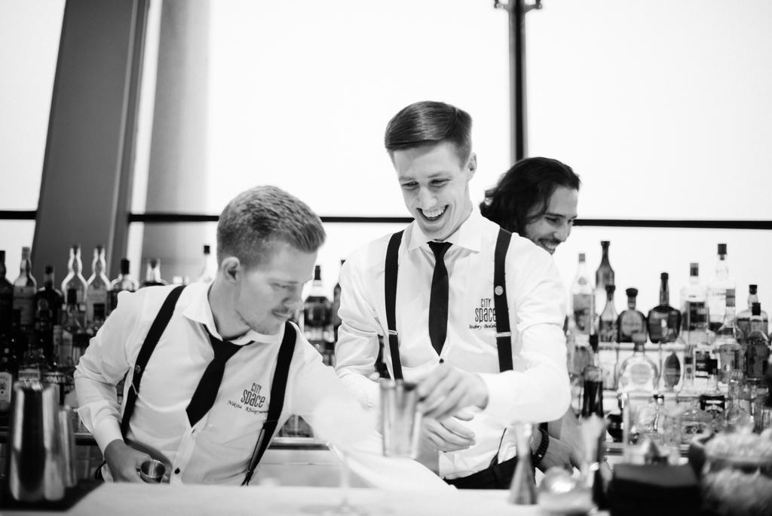
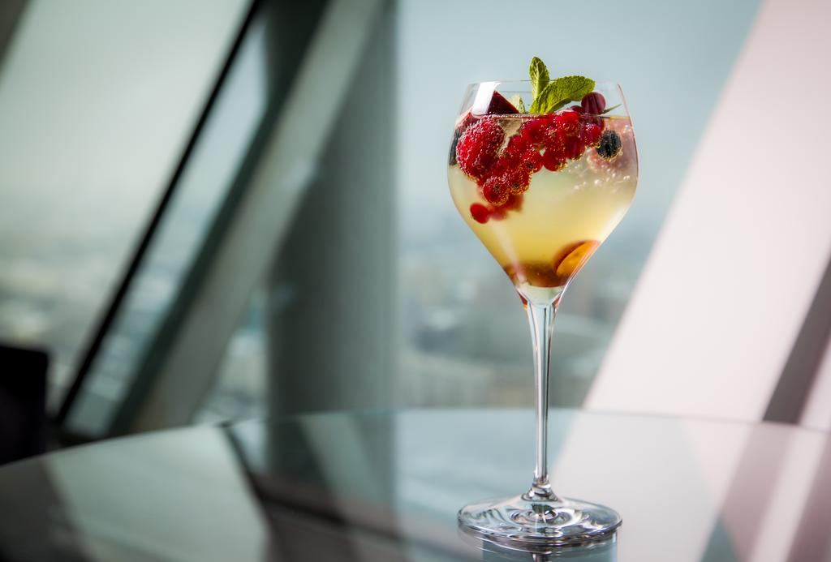
City space bar & restaurant
The trendy City Space Bar & Restaurant, one of the world’s top ten bars, is the perfect place to sip a cocktail while enjoying amazing 360-degree exciting views of Moscow’s city center.
One of the highest panoramic bars of Moscow (140 m)
Offers breathtaking 360 degrees view of Moscow
Unique for its variety of cocktails: cold or hot, classic or molecular
Highly professional bartenders of City Space Bar & Restaurant regularly win various bartender competitions and awards
Features Pan Asian cuisine
“The most subtle scents produce the best fragrances.”
Lavender
Rosemary
Cypress Bark
Spruce

Slide 21
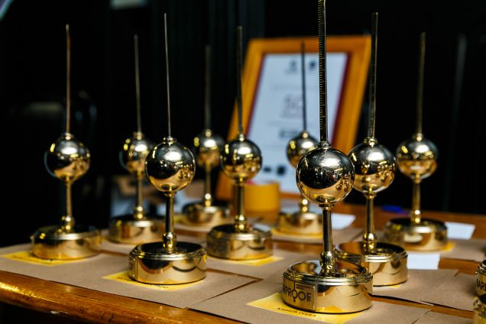
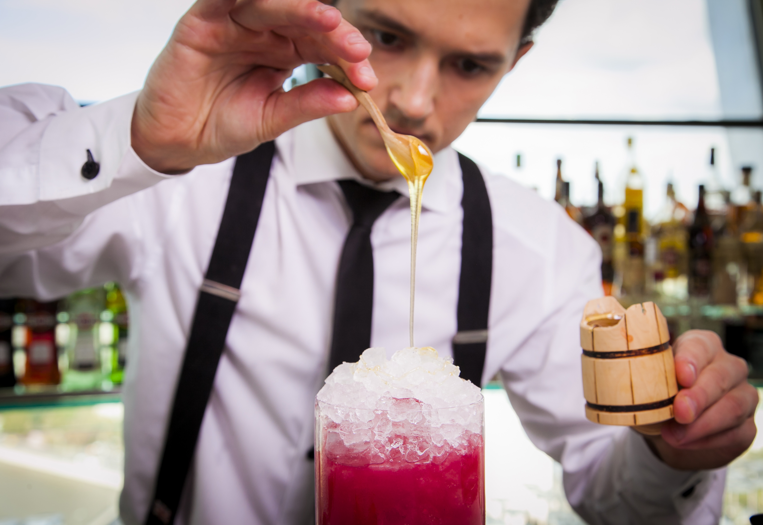
Award-winning bar
Bar of the year 2018 (Luxury Travel Guide Awards)
The Best Bartender of Russia 2018 by Calvados Nouvelle Vogue International Trophies (Artur Dronov)
The Best Bartender of Russia 2016 according to the World Cocktail Championship and Ultimate Monin Cup (Nikita Khlopyanov)
The Best Bartender of Russia 2017 by Calvados Nouvelle Vogue International Trophies (Nikita Khlopyanov)
The winner of Neon Shaker Awards 2016 (Nikita Khlopyanov)
The Best Mixologist of the Year 2016 (Nikita Khlopyanov)
City Space Bar & Restaurant - Best Hotel Bar 2016 (Bar Proof Award)
Best Bartender 2012 - Diageo World Class (Andrey Zastavnyuk)
City Space – included into the list “The 2011 World’s 50 Best Bars”
City Space Bar & Lounge – Bar of The Year Moscow Out, Russia Today TV channel 2010
City Space Bar & Lounge – World’s Top Ten Bar Bartender’s Guide 2008
“The most subtle scents produce the best fragrances.”

Slide 22
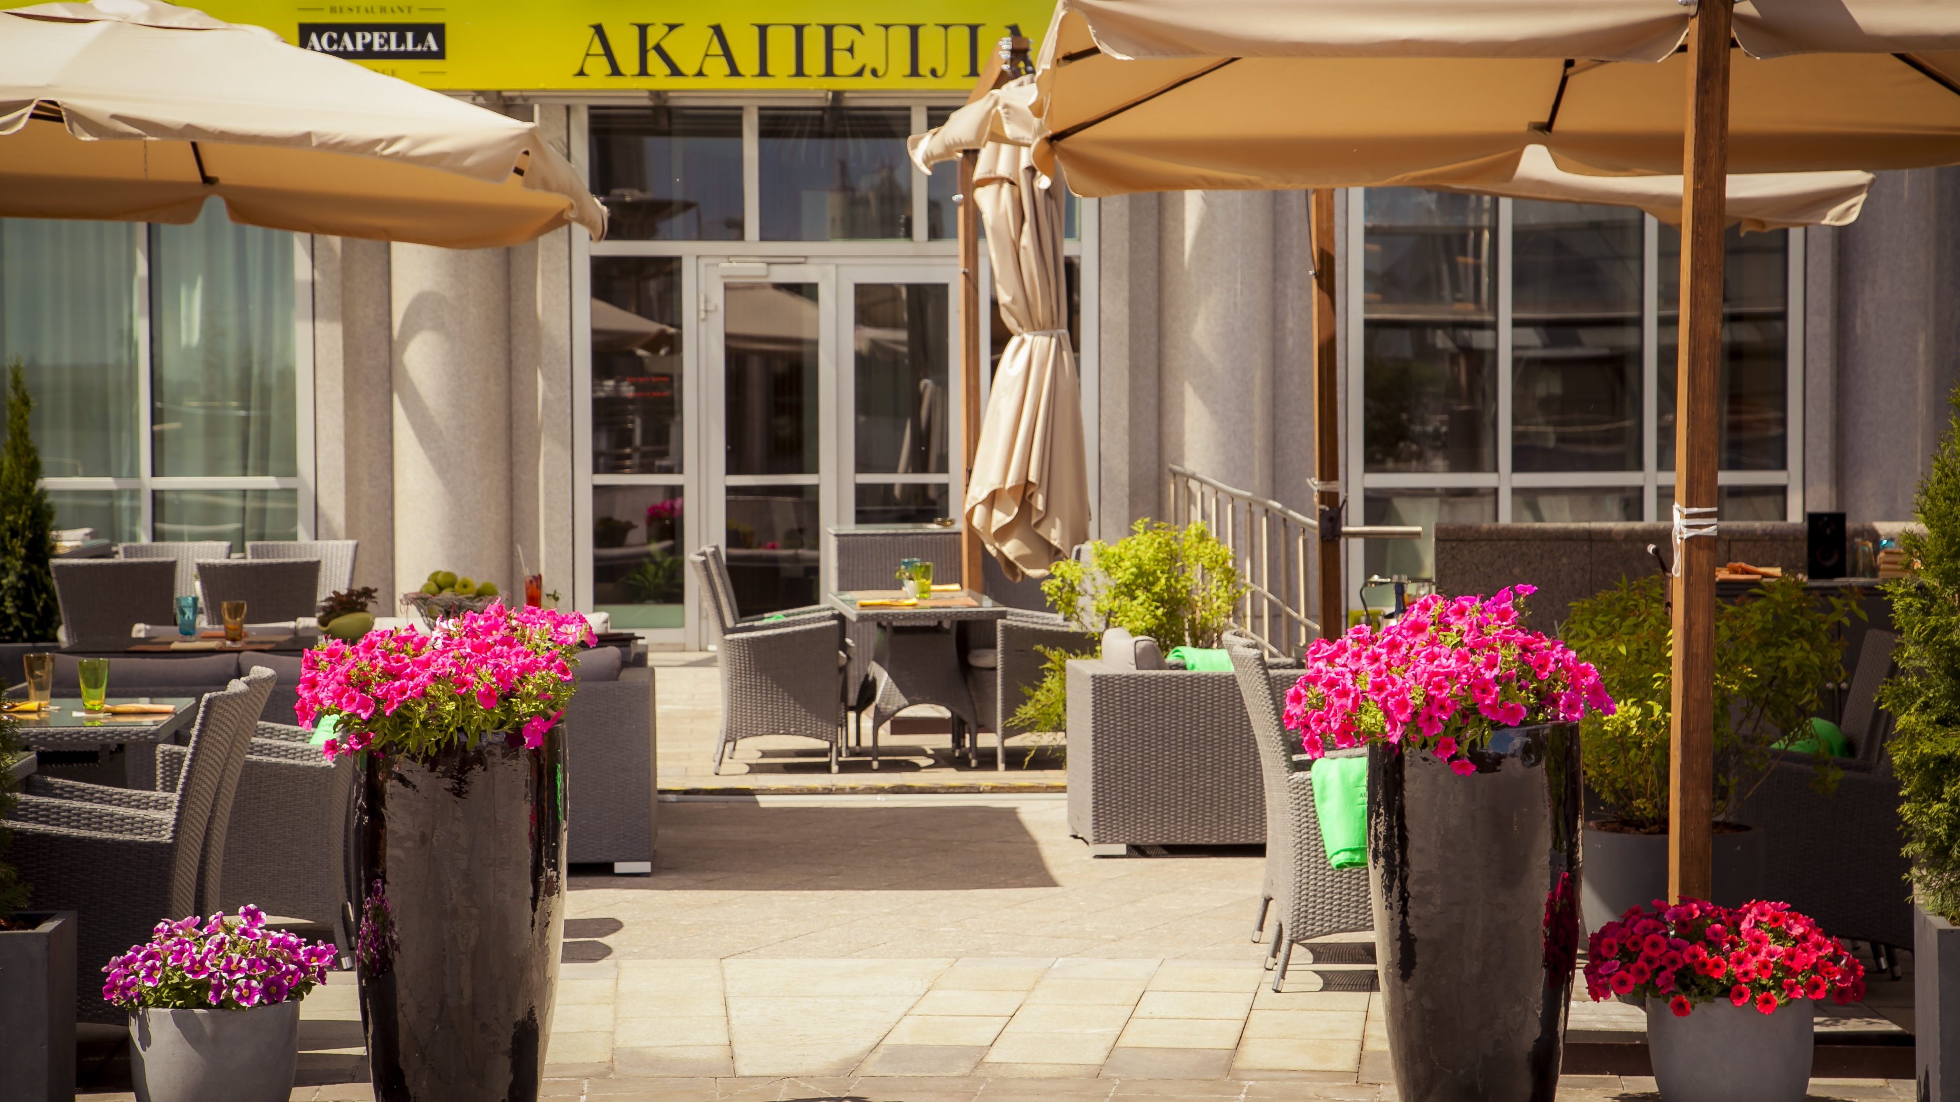
Acapella
Elegant “Acapella” Restaurant & Lounge located on the 2nd floor is the main restaurant in Swissotel Krasnye Holmy.
The restaurant offers contemporary international cuisine, focusing on local, eco-friendly, organic and seasonal produce using modern cooking techniques.
Exuding style and personality it is an ideal place for breakfast, lunch or dinner and also for a business or private get-together.

Slide 23
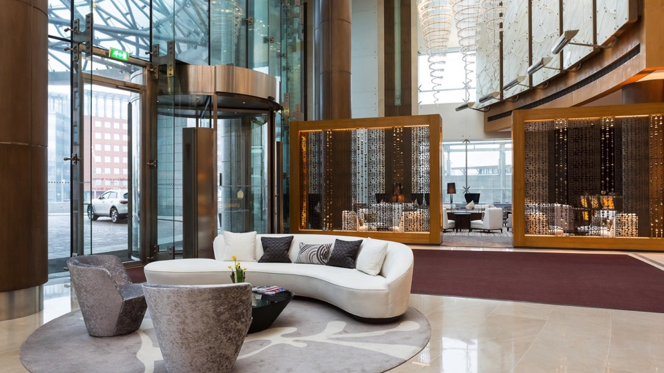
Lightbar
Lightbar provides the perfect atmosphere for an informal get-together, an afternoon tea or simply for enjoying a glass of your favourite wine. Located at the lobby level, Lightbar is flooded with natural daylight and discreetly lit in the evening, a perfect combination for a warm and soothing ambience. Enjoy light meals, beverages and coffee or tea with a perfect choice of freshly baked cakes and pastries from Swissotel Krasnye Holmy, Moscow’s pastry chef.

Slide 24
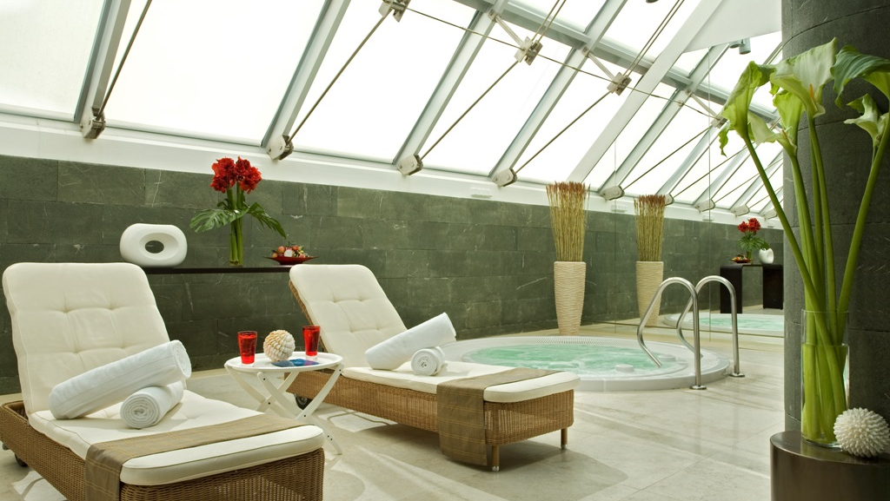
PÜROVEL
SPA & SPORT

Slide 25
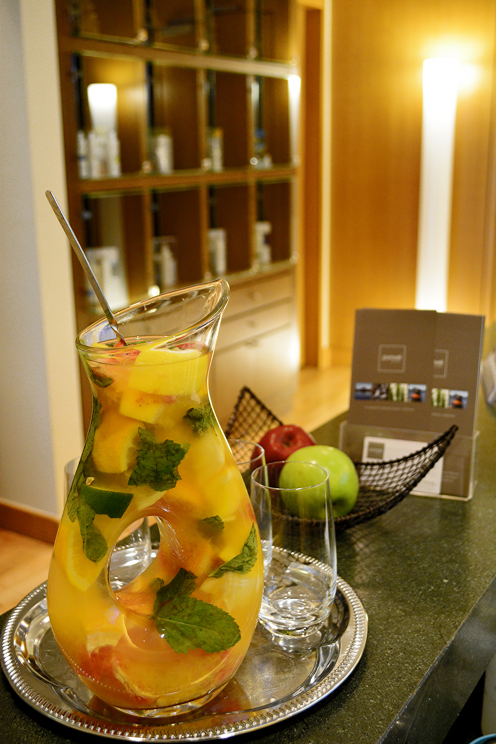
PÜROVEL Spa & sport
Pürovel Spa & Sport provides a Swiss-inspired solution to healthy living for everyone.
Pürovel spa treatments use essential oils organically produced in Switzerland.
Located on the 3rd floor of Swissotel Krasnye Holmy Moscow.
Facilities:
Spa with Swiss Cosmetics
Swimming pool
Gym
Sauna
Jacuzzi
Spa treatments and massages
Manicure and pedicure salon

Slide 26
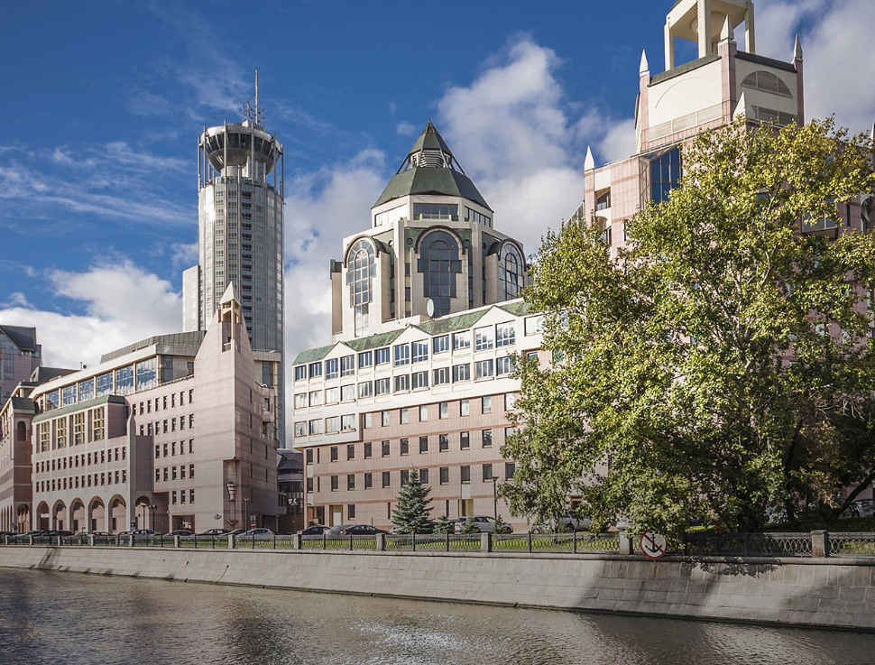
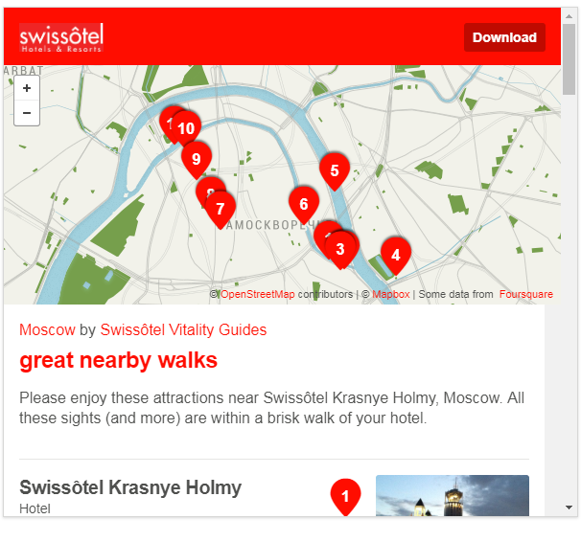
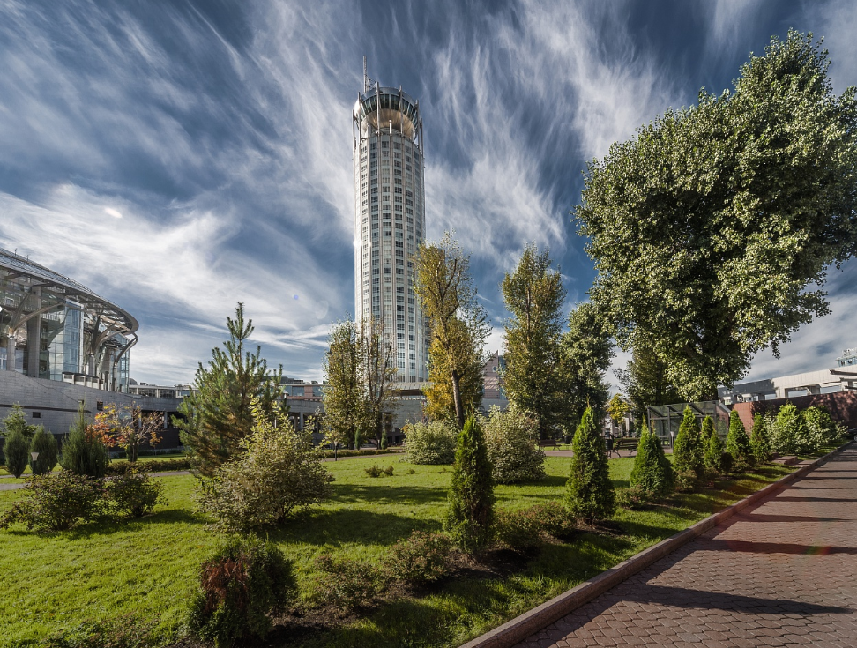
Moscow Vitality Guide
by Swissôtel Krasnye Holmy
“The slower you go, the more you can see.”
Curated by Alpinist and travel writer John Harlin, enjoy these attractions near Swissotel Krasnye Holmy Moscow. These sites are within a brisk walk from your hotel, and by exploring the neighborhoods, you may go ahead and share your discovery.

Slide 27
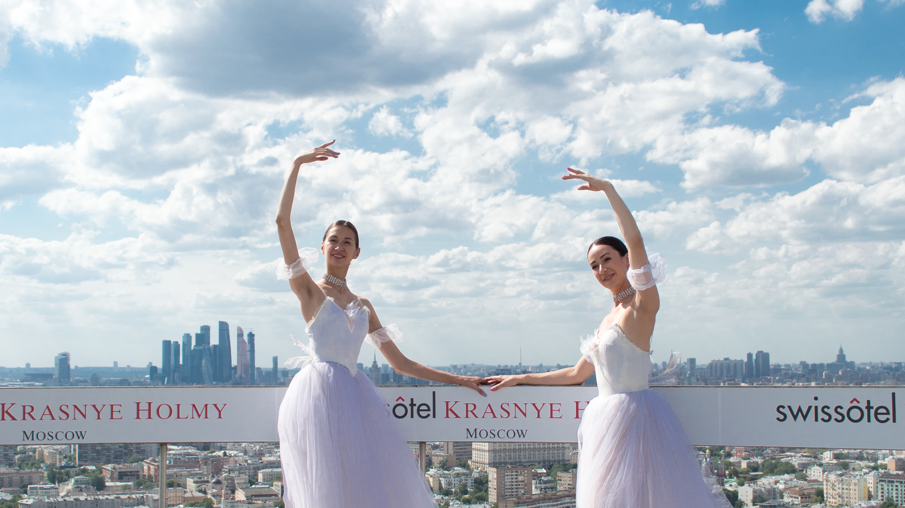
Feel
Welcome

